Slide 1
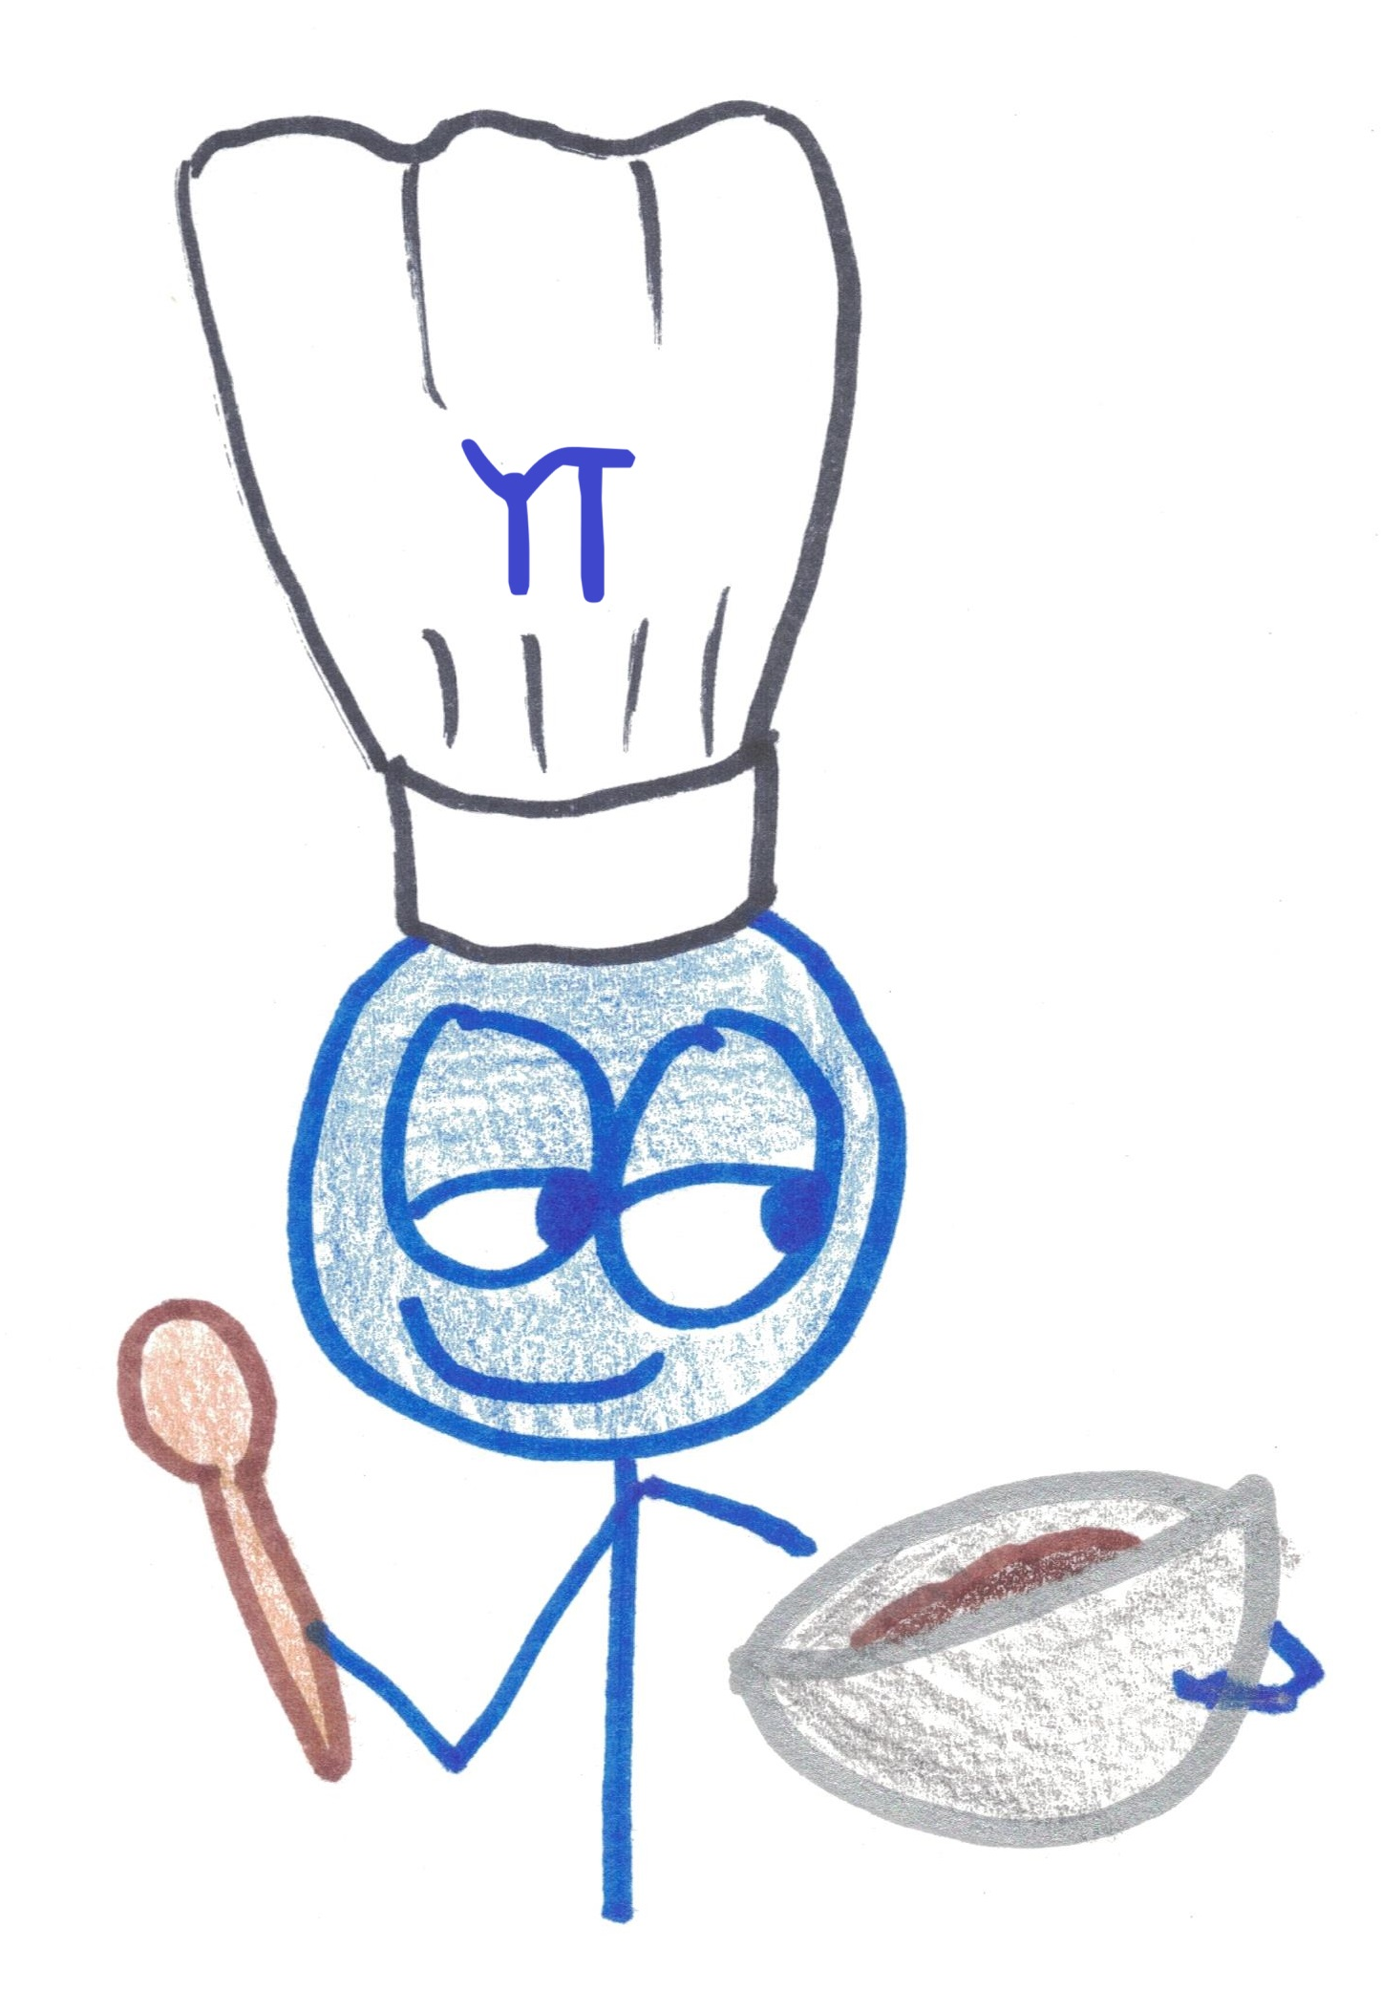
The Importance of Eating Brownies
Life Lessons / Geometry Lessons

Slide 2
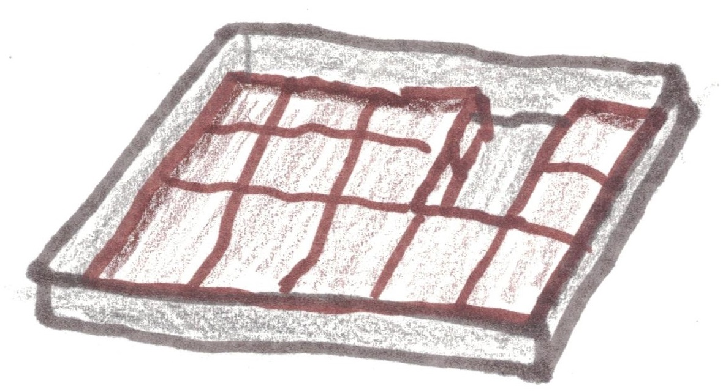
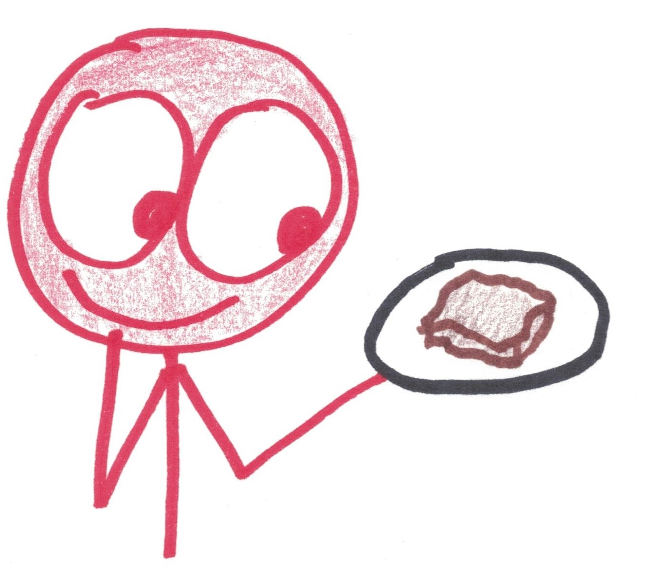
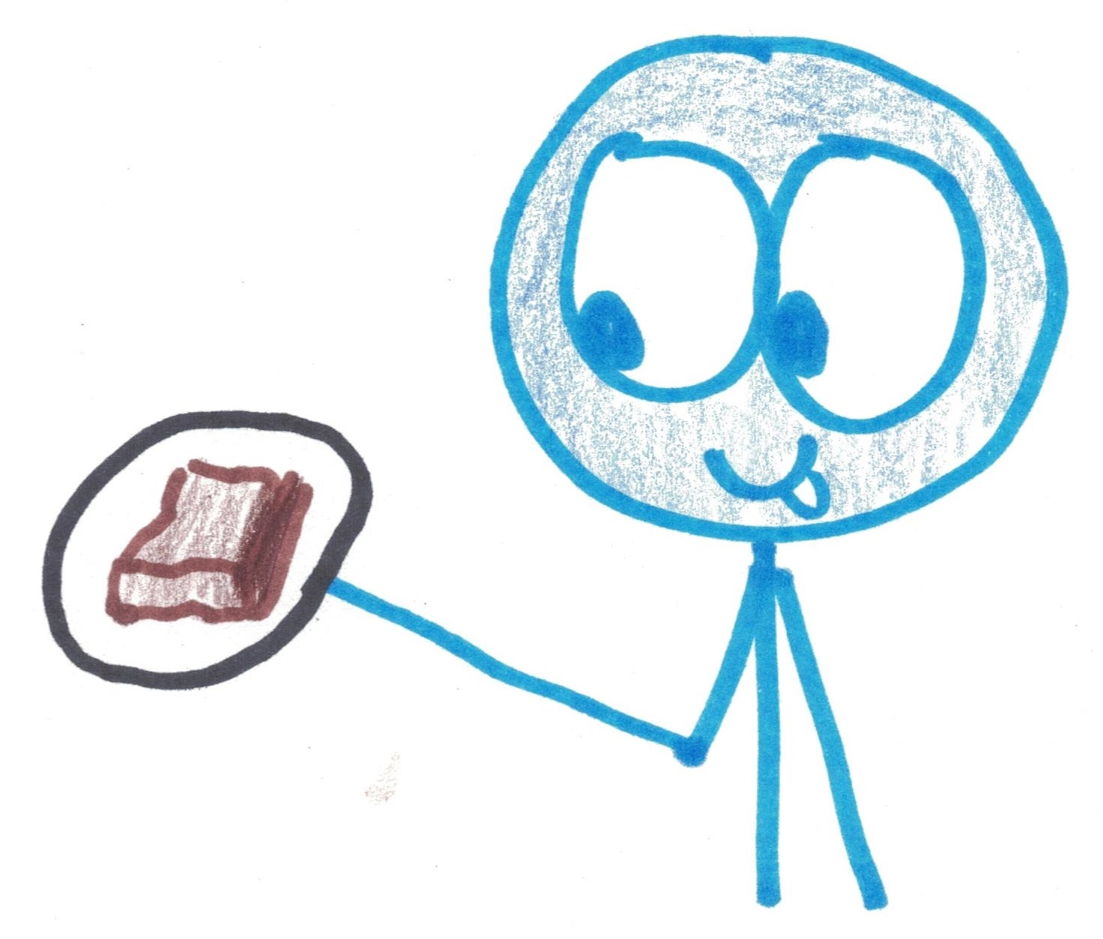
Do you prefer middle or edge brownies?

Slide 3
What pan will give them equal brownies?
MIDDLE-INE
EDGE-GAR

Slide 4
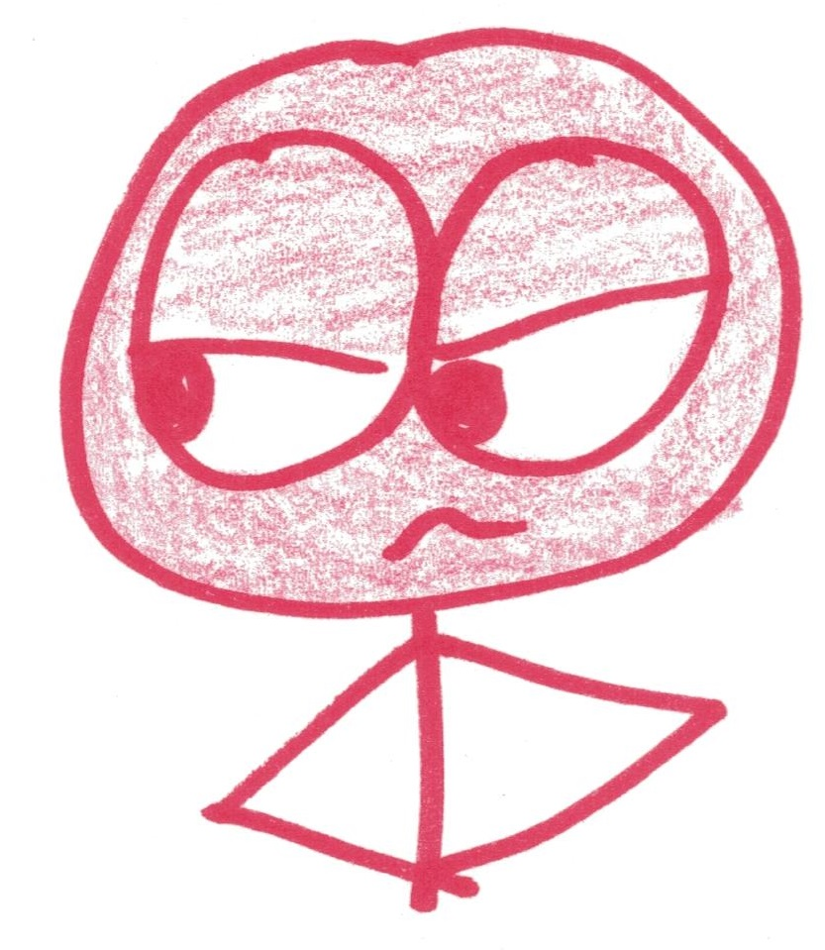

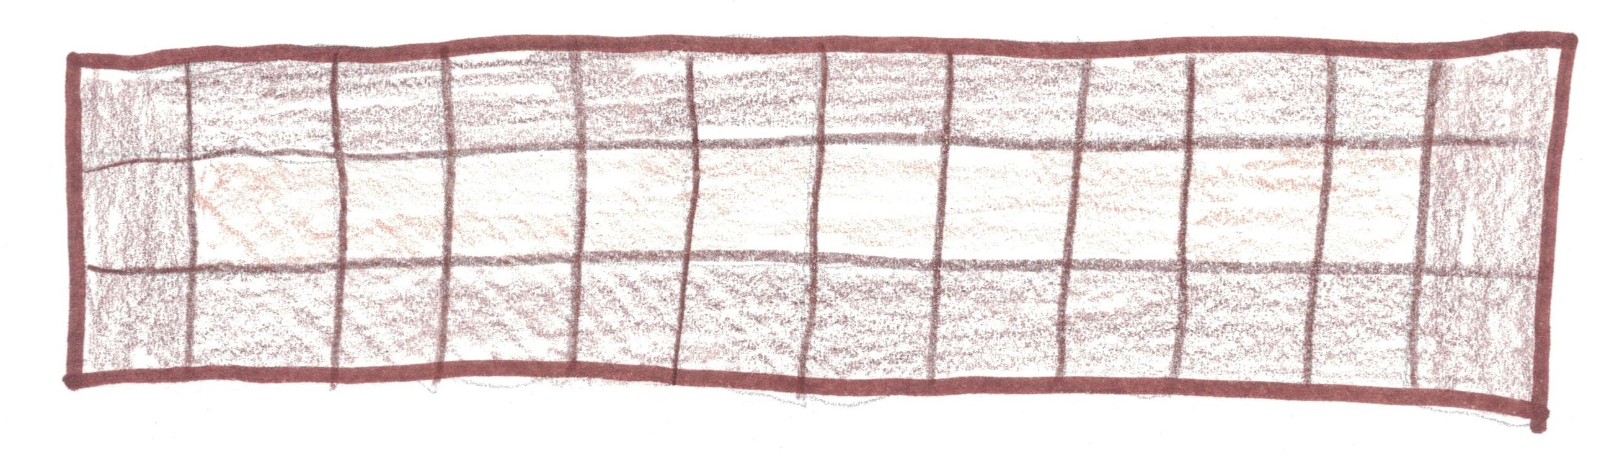
Edgegar:
“How about 12 x 3?”
10
26

Slide 5

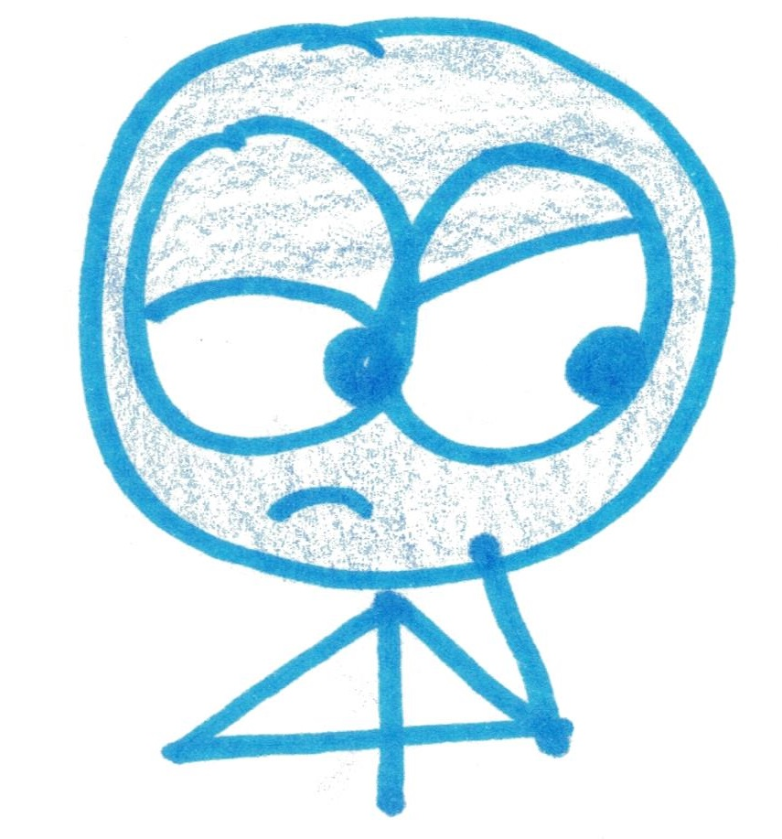
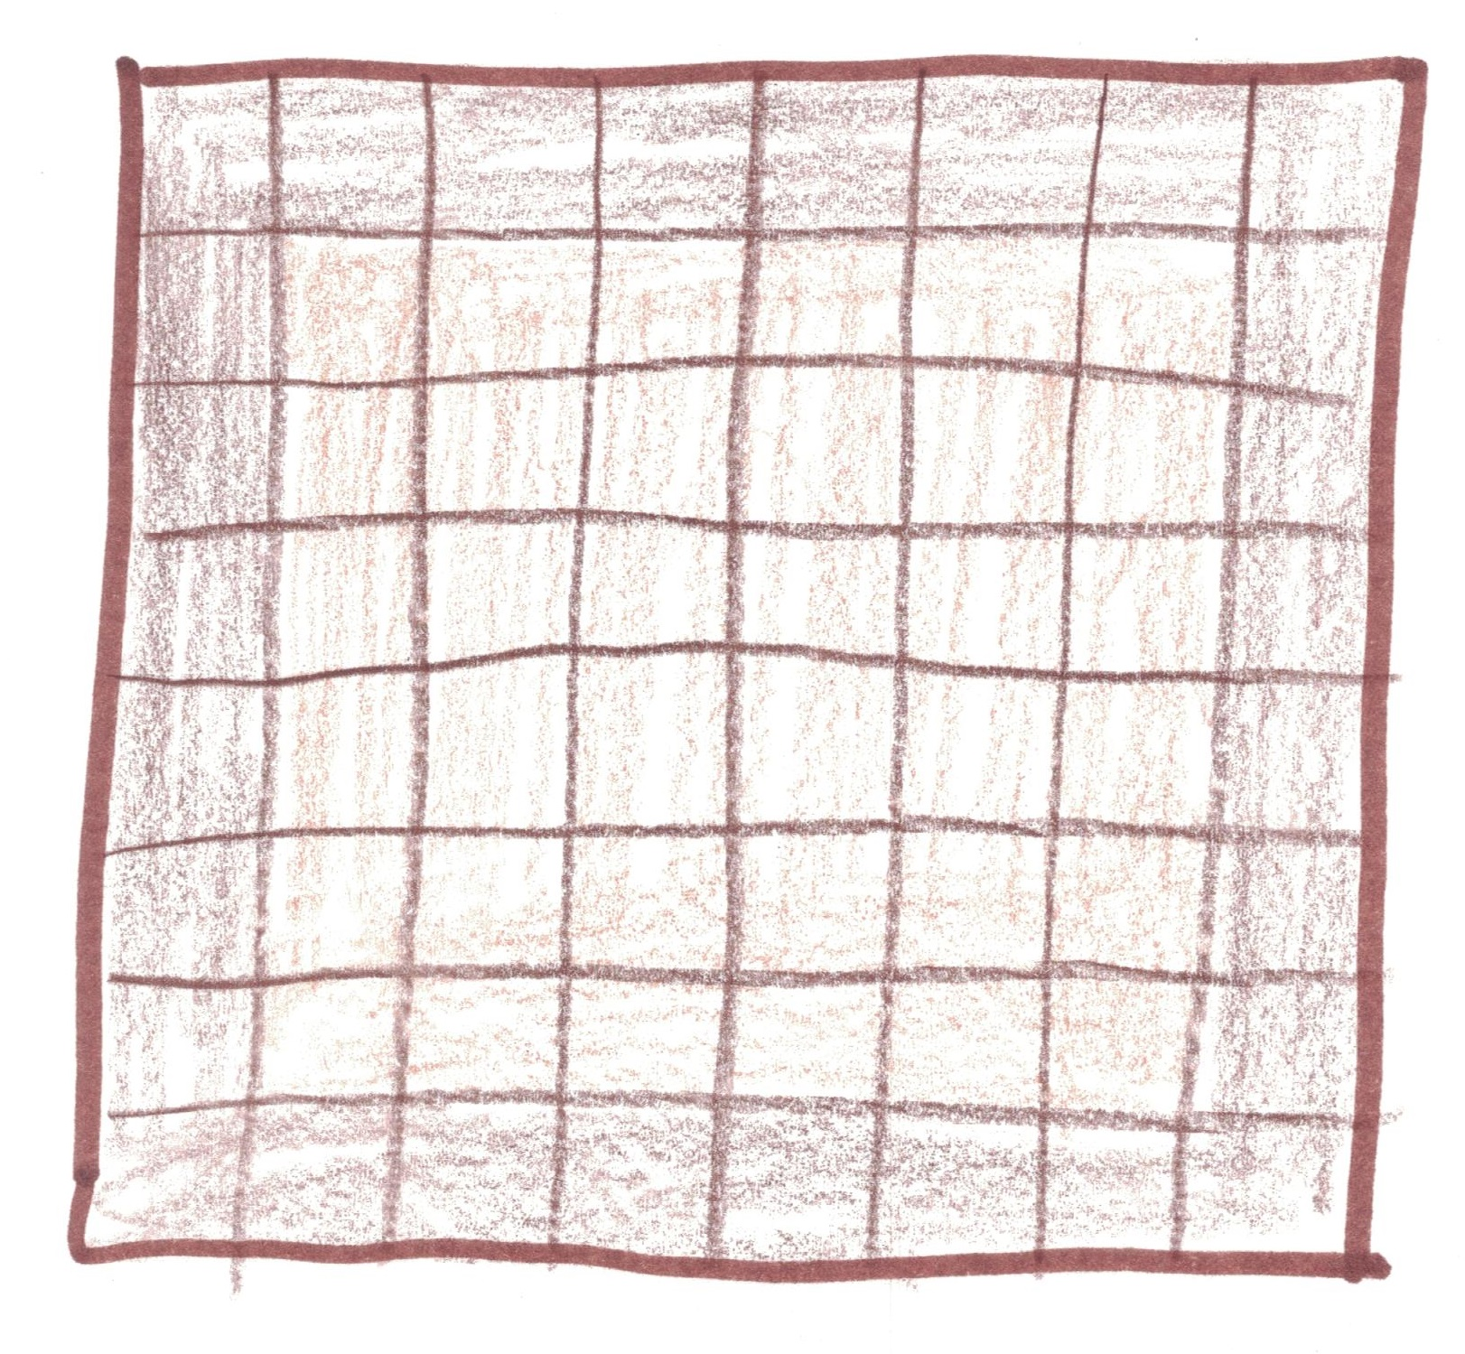
Middleine:
“How about 8 x 8?”
36
28

Slide 6
Two rectangular pans give equal numbers of center and edge brownies. Can you find them?

Slide 7
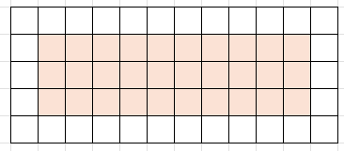
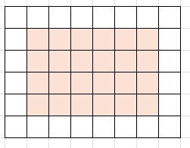
5 x 12
30 of each
3 x 10
6 x 8
24 of each
4 x 6

Slide 8
What happens with an A x B rectangle?
Total: A x B
Middles: (A – 2)(B – 2)
Edges: 2A + 2B - 4

Slide 9
Total = 2 x Middles
AB= 2(A – 2)(B – 2)
All: A x B
Middles: (A – 2)(B – 2)
Edges: 2A + 2B - 4

Slide 10
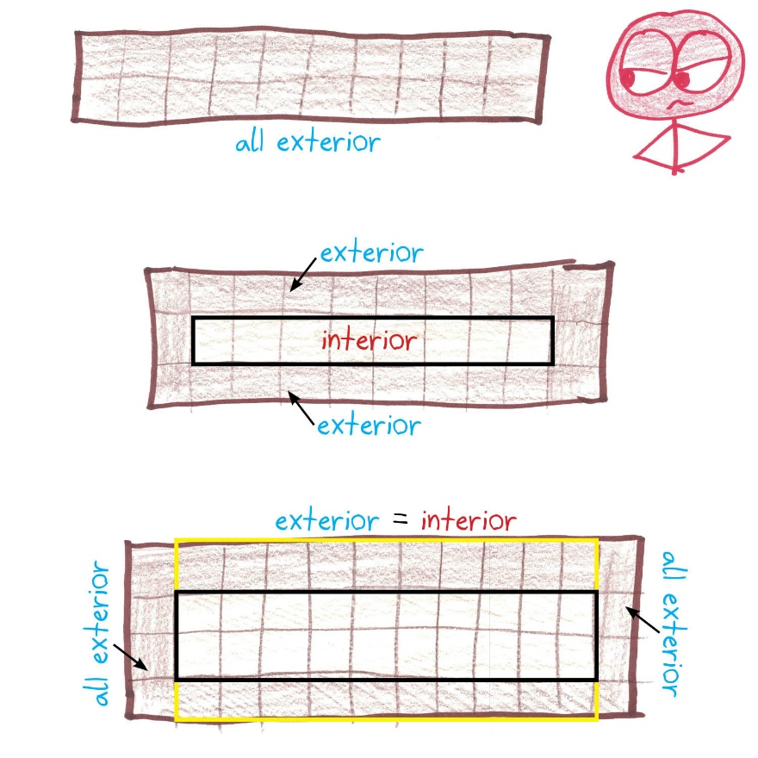
Could the pan have B = 2?

Slide 11
Could the pan have B = 3?

Slide 12
Could the pan have B = 4?

Slide 13
Could the pan have B = 5?
AB= 2(A – 2)(B – 2)
A5 = 2(A – 2)(5 – 2)
5A = 6(A – 2)
5A = 6A – 12
12 = A

Slide 14
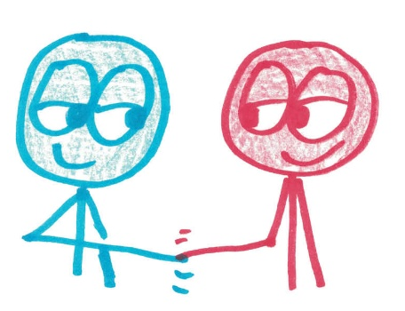
Could the pan have B = 6?
AB= 2(A – 2)(B – 2)
A6 = 2(A – 2)(6 – 2)
6A = 8(A – 2)
6A = 8A – 16
16 = 2A
8 = A

Slide 15
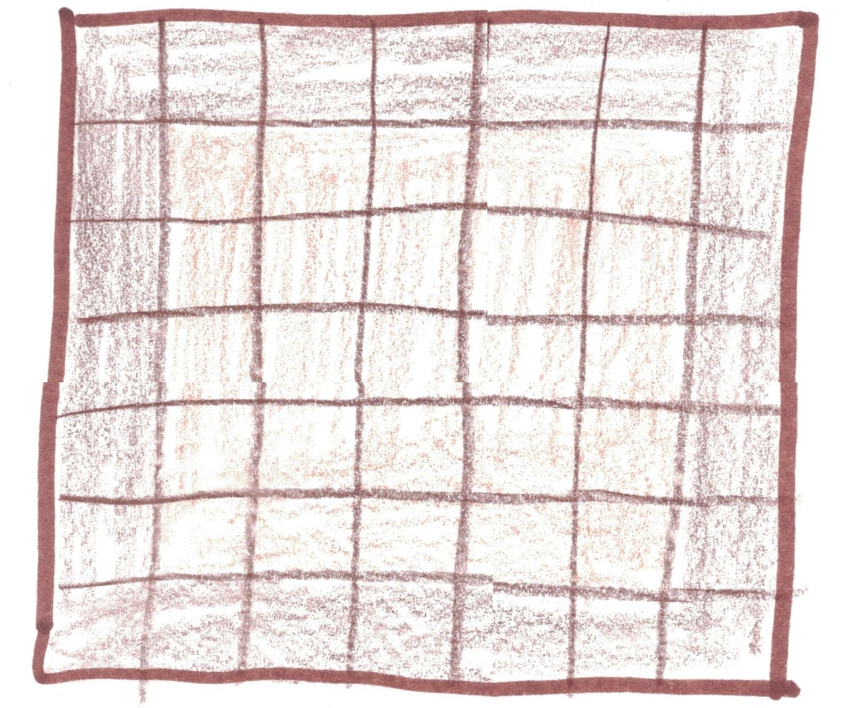
Could the pan have B = 7?
25 center
24 exterior
Already too big!

Slide 16
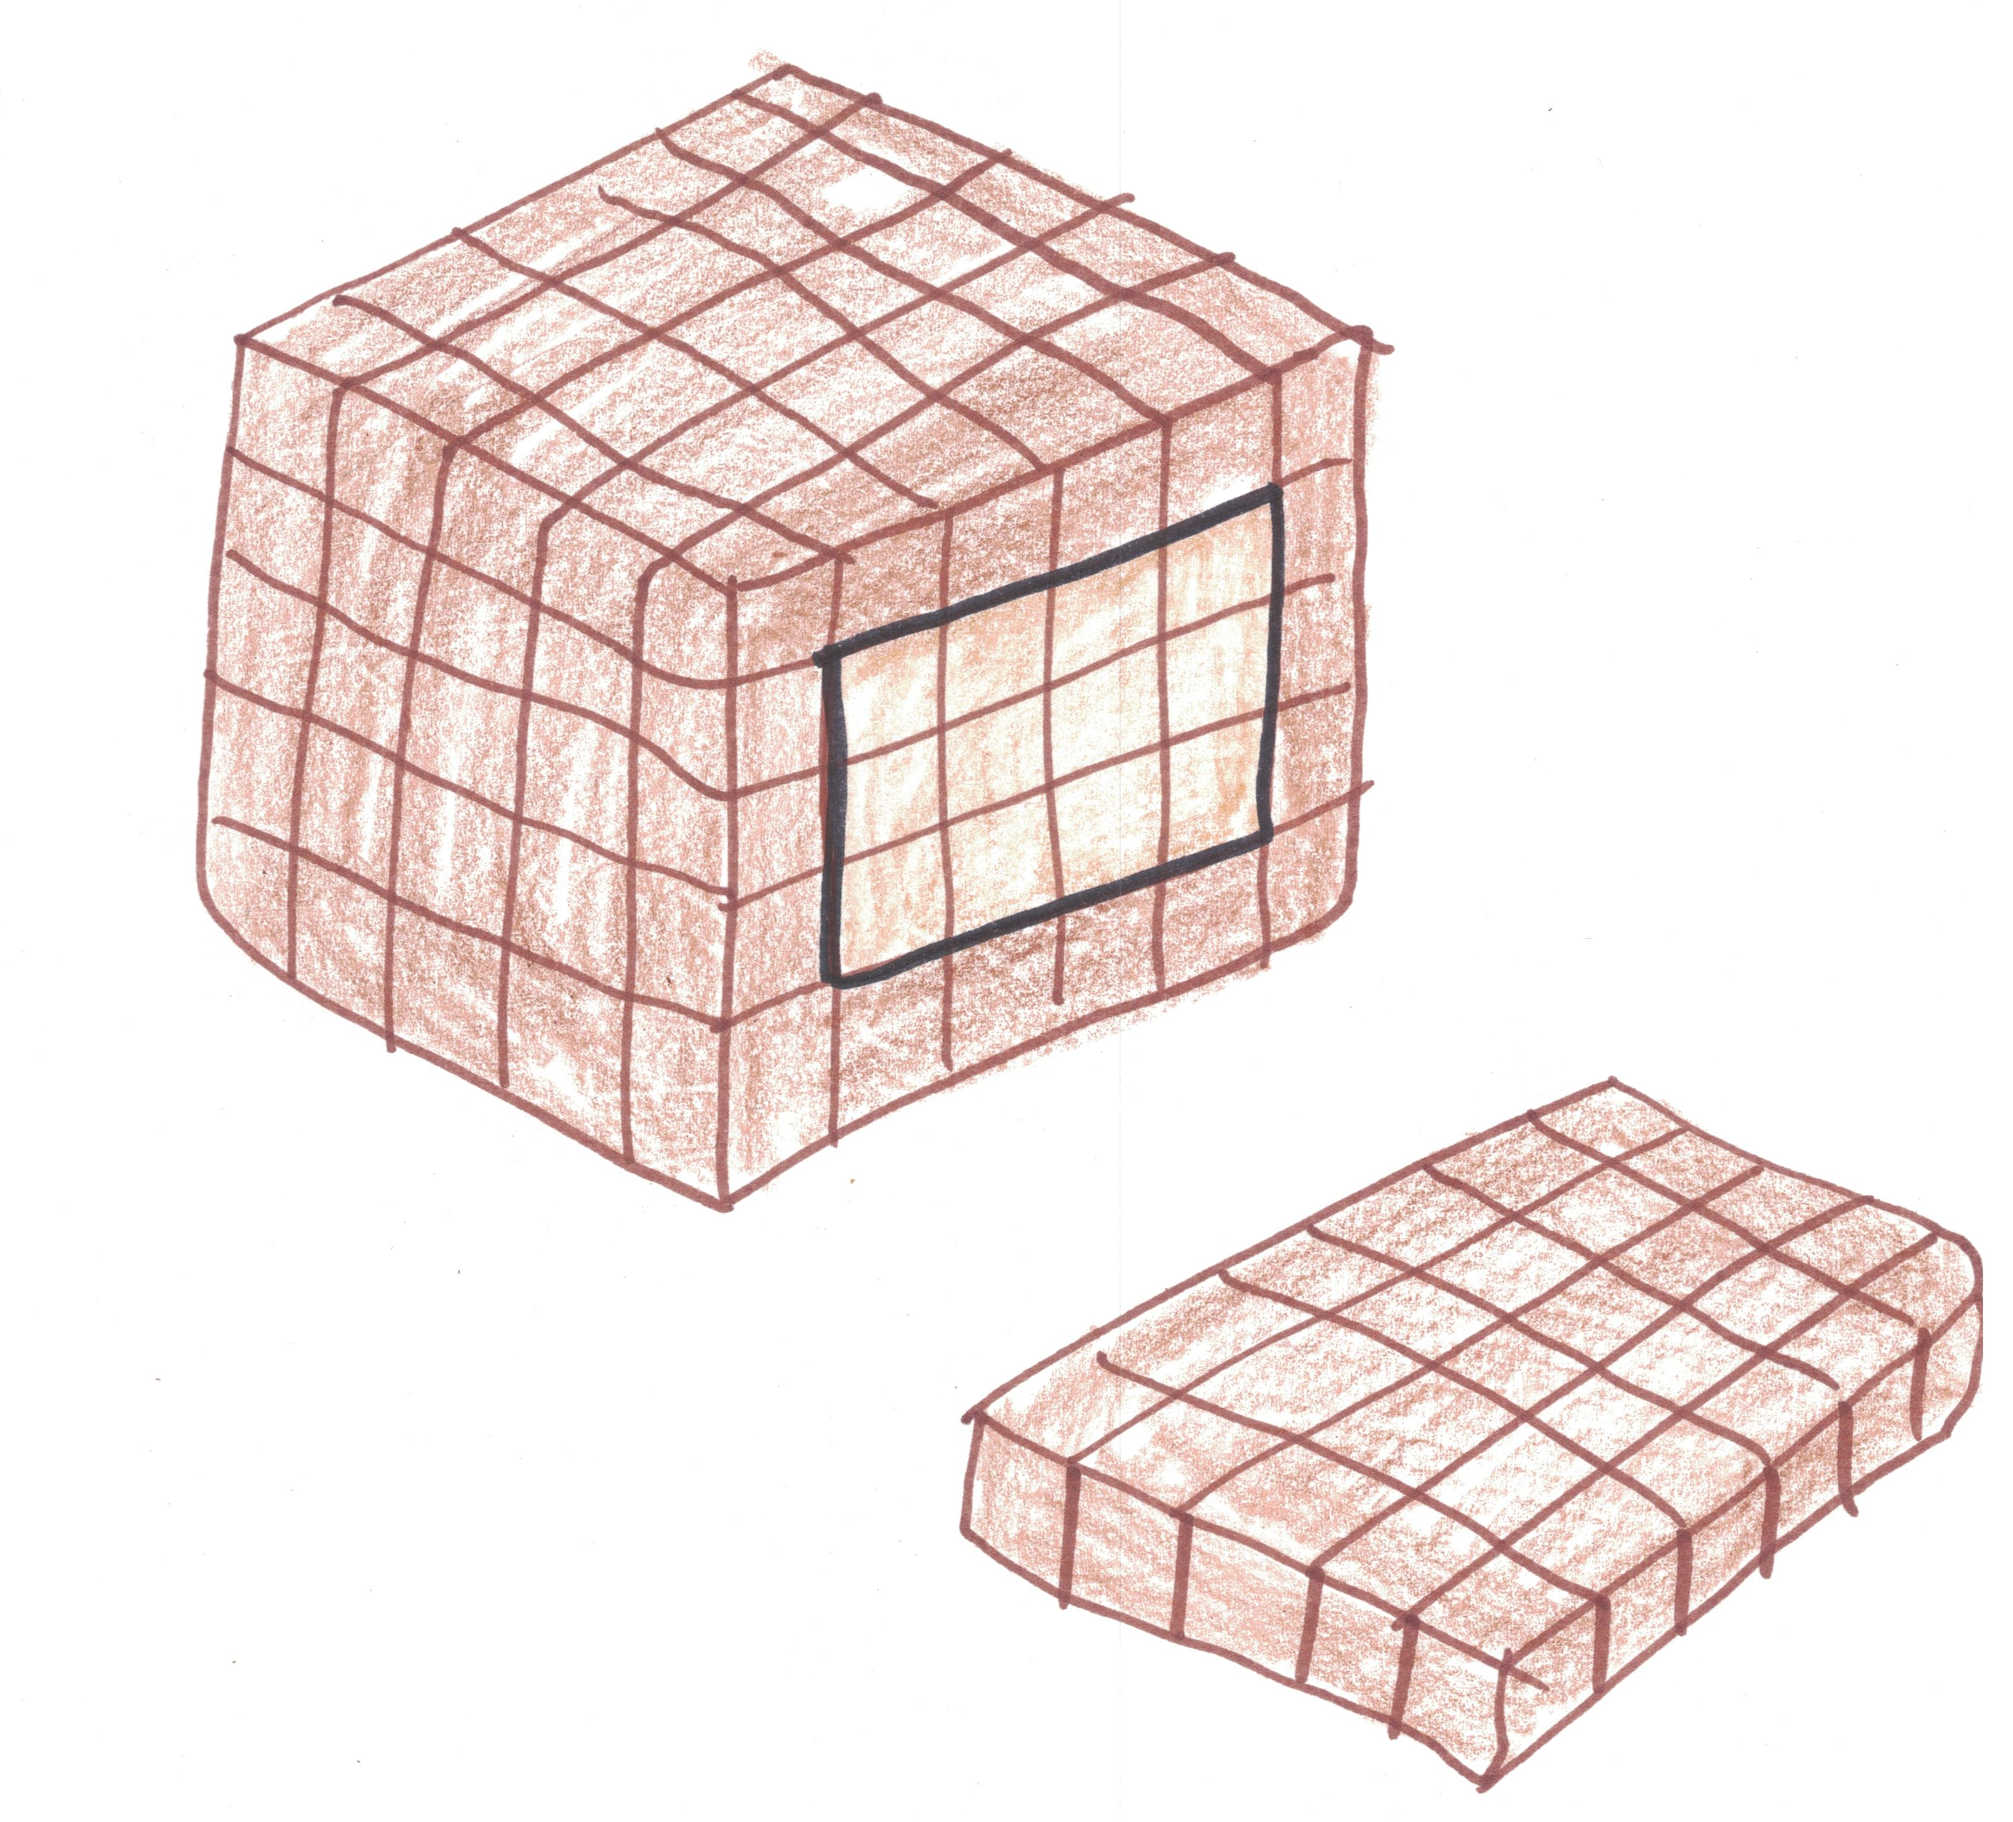
Bonus: The friends start baking 3D brownie loaves. Can you find a rectangular prism loaf with equal numbers of interior and exterior brownies?

Slide 17
One solution is 7 x 9 x 20.
Total: 7 x 9 x 20 = 1260
Interior: 5 x 7 x 18 = 630

