Slide 1
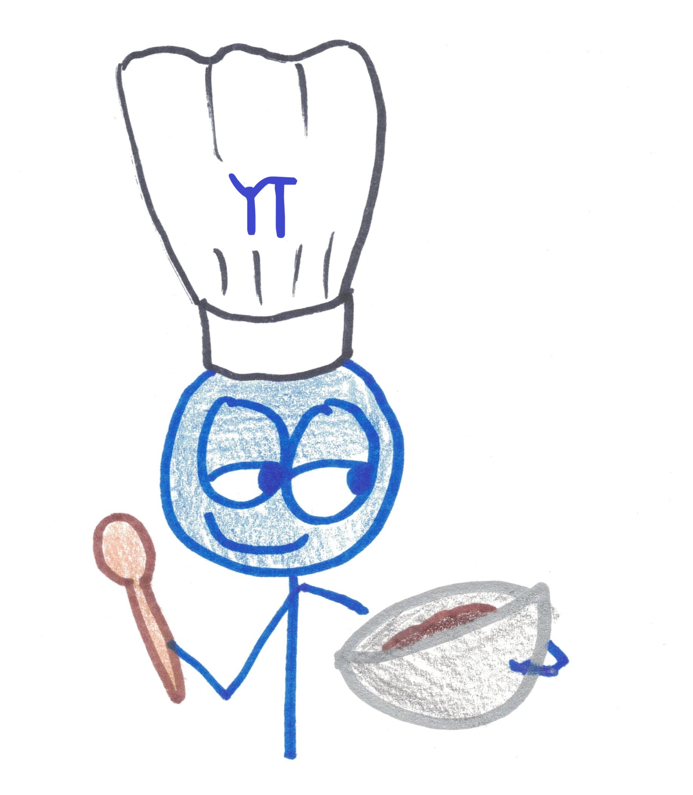
The Importance of Eating Brownies
Life Lessons / Geometry Lessons

Slide 2
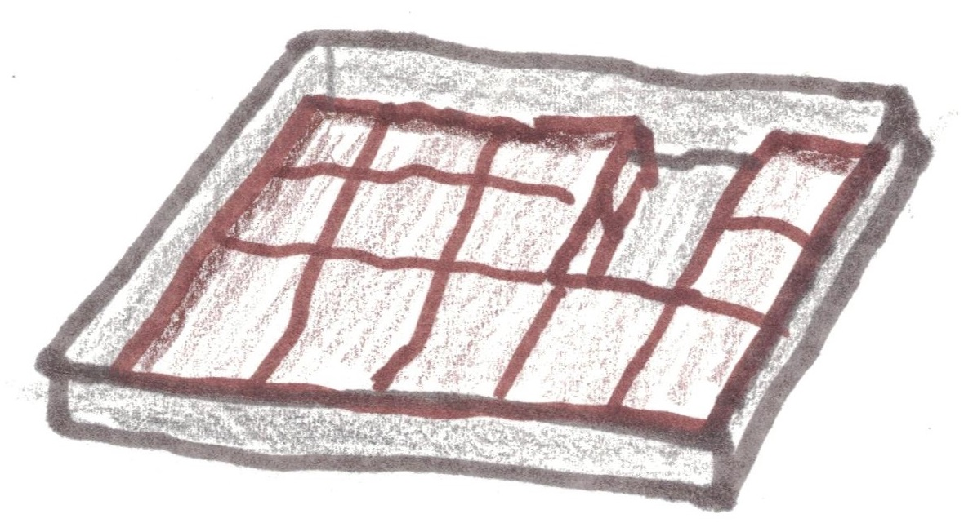
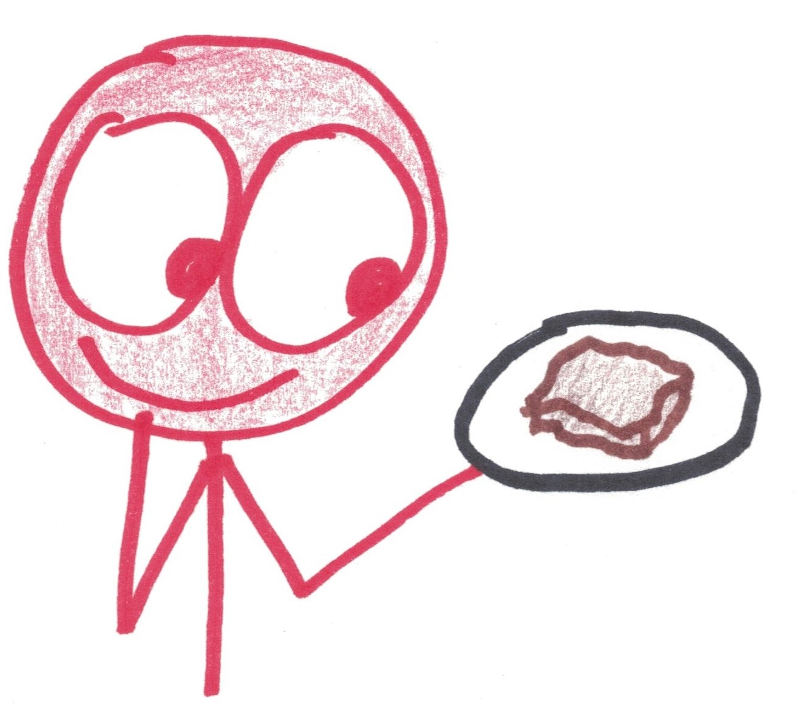
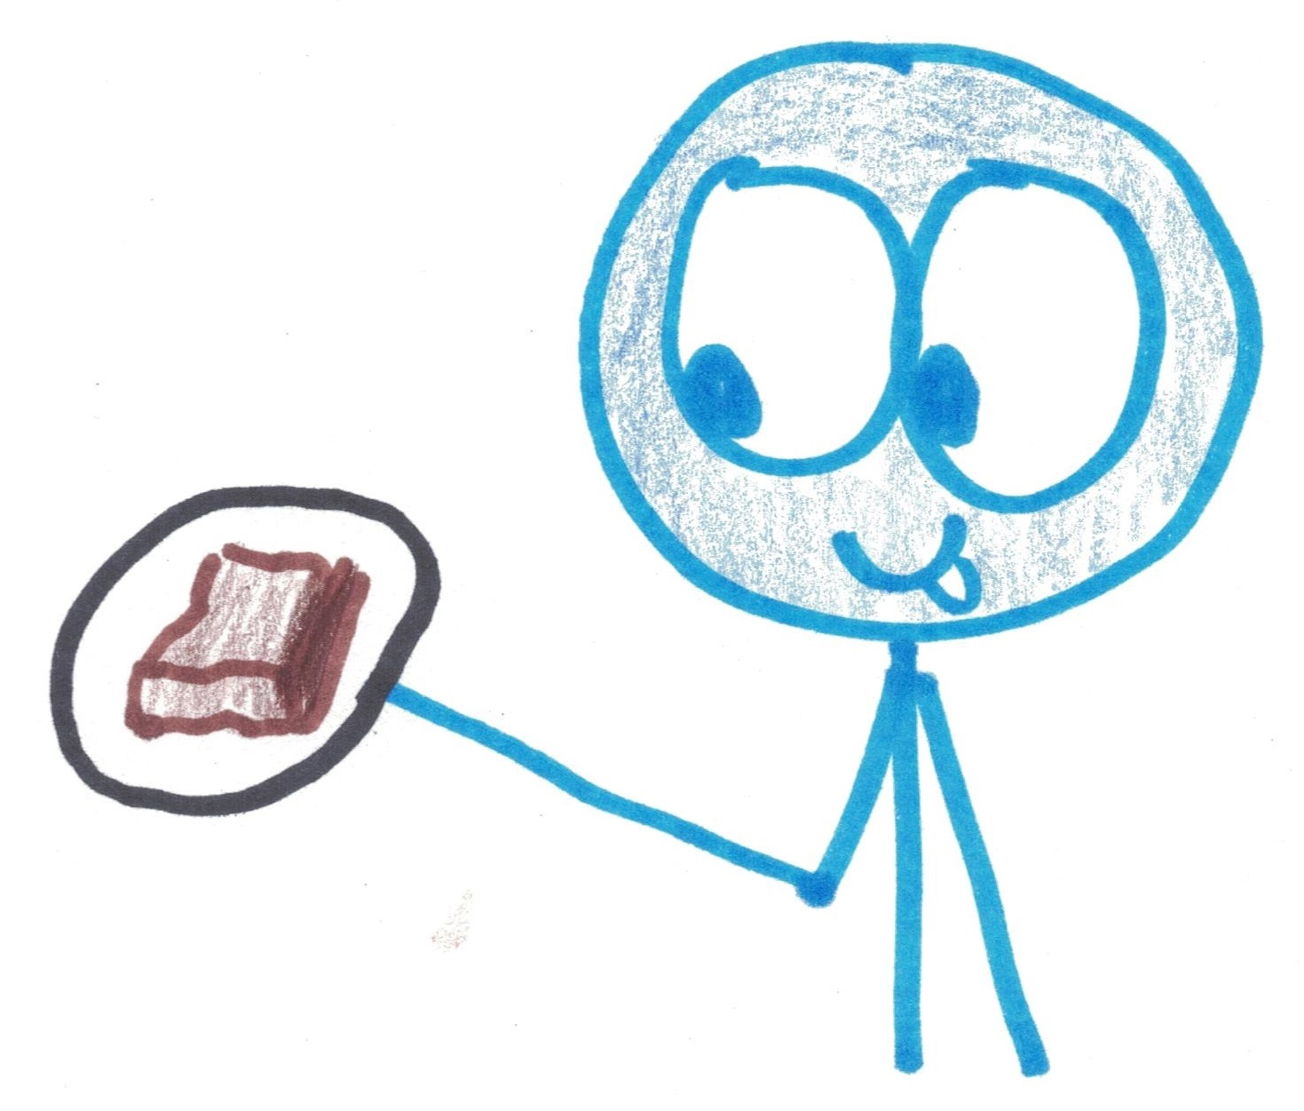
Do you prefer middle or edge brownies?

Slide 3
What pan will give them equal brownies?
MIDDLE-INE
EDGE-GAR

Slide 4
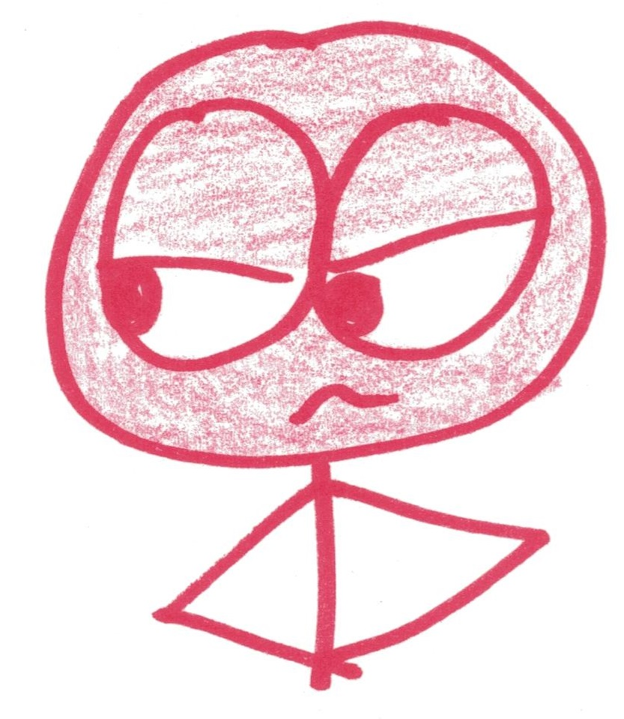

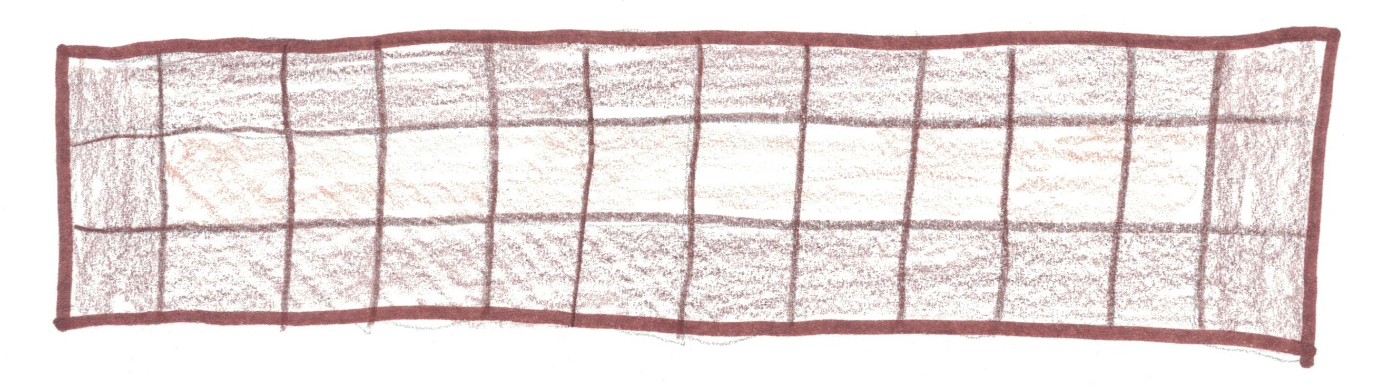
Edgegar:
“How about 12 x 3?”
10
26

Slide 5

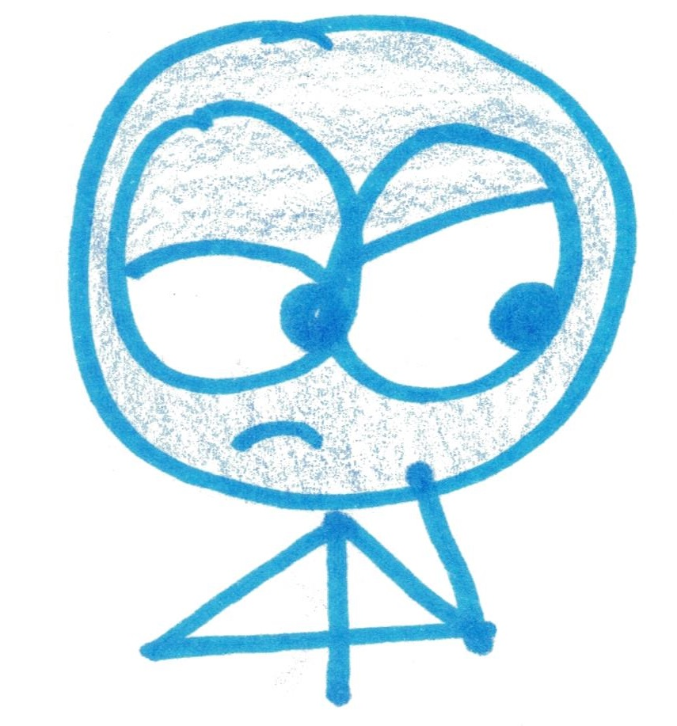
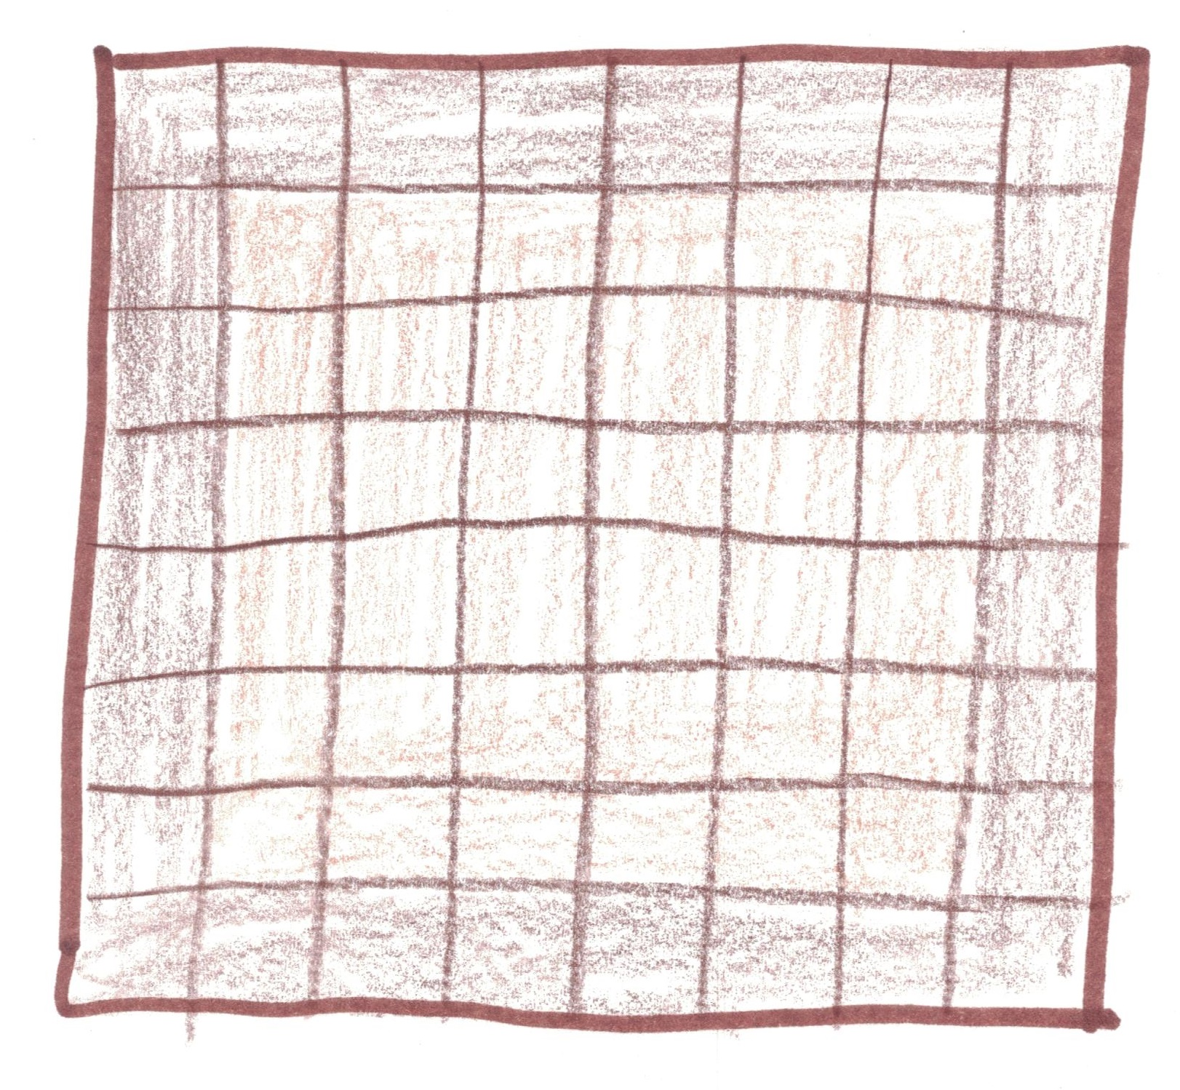
Middleine:
“How about 8 x 8?”
36
28

Slide 6
Two rectangular pans give equal numbers of center and edge brownies. Can you find them?

Slide 7
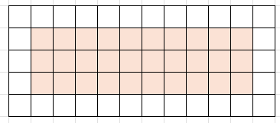
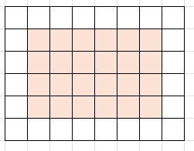
5 x 12
30 of each
3 x 10
6 x 8
24 of each
4 x 6

Slide 8
What happens with an A x B rectangle?
Total: A x B
Middles: (A – 2)(B – 2)
Edges: 2A + 2B - 4

Slide 9
Total = 2 x Middles
AB= 2(A – 2)(B – 2)
All: A x B
Middles: (A – 2)(B – 2)
Edges: 2A + 2B - 4

Slide 10
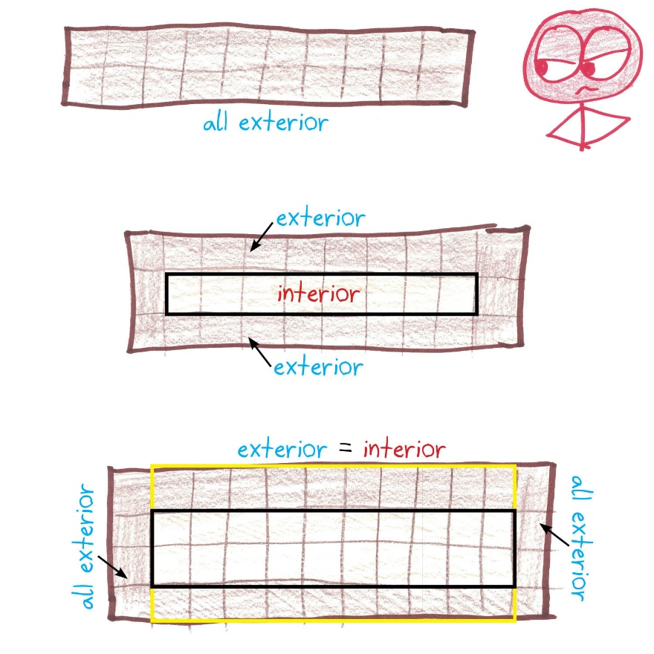
Could the pan have B = 2?

Slide 11
Could the pan have B = 3?

Slide 12
Could the pan have B = 4?

Slide 13
Could the pan have B = 5?
AB= 2(A – 2)(B – 2)
A5 = 2(A – 2)(5 – 2)
5A = 6(A – 2)
5A = 6A – 12
12 = A

Slide 14
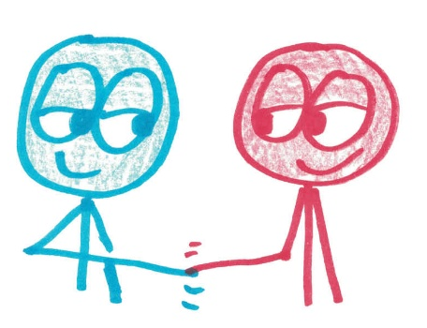
Could the pan have B = 6?
AB= 2(A – 2)(B – 2)
A6 = 2(A – 2)(6 – 2)
6A = 8(A – 2)
6A = 8A – 16
16 = 2A
8 = A

Slide 15
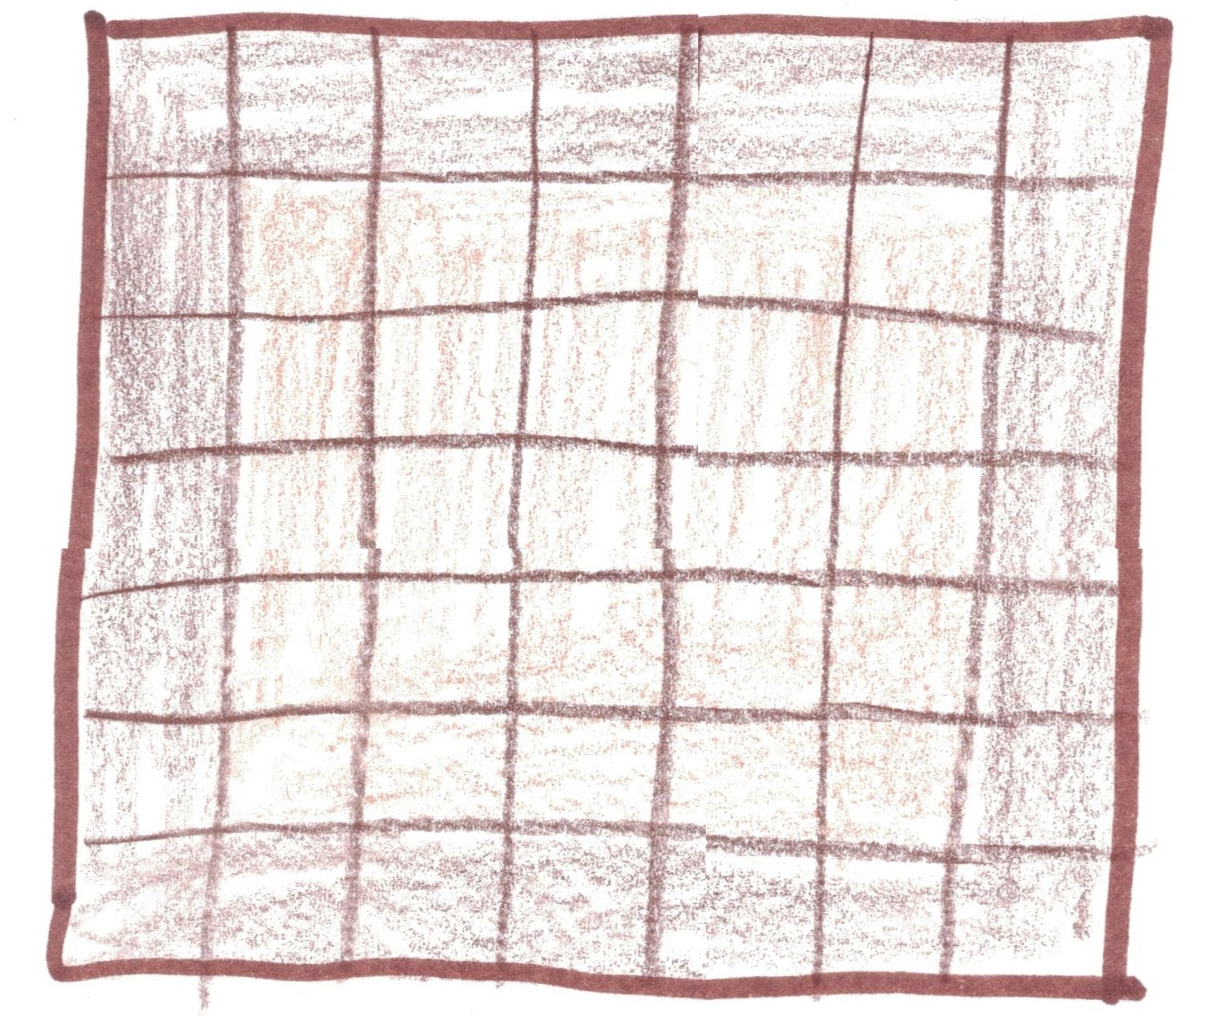
Could the pan have B = 7?
25 center
24 exterior
Already too big!

Slide 16
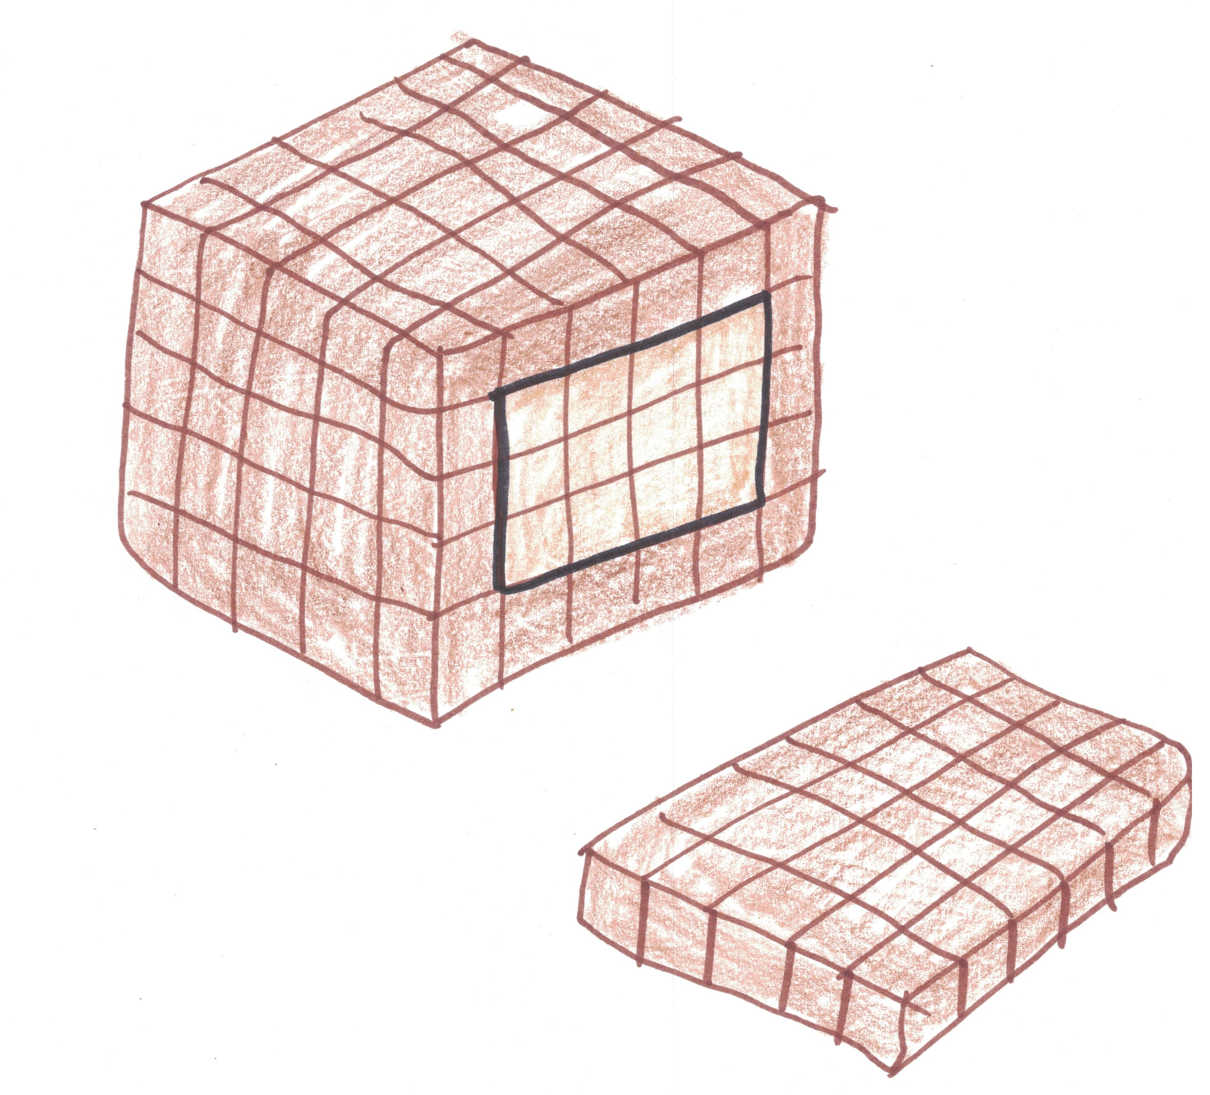
Bonus: The friends start baking 3D brownie loaves. Can you find a rectangular prism loaf with equal numbers of interior and exterior brownies?

Slide 17
One solution is 7 x 9 x 20.
Total: 7 x 9 x 20 = 1260
Interior: 5 x 7 x 18 = 630

Slide 18
Brownie Theory
A Brief, Sweet Account of Existence

Slide 19
Every object is made of middle brownies and edge brownies.
area
volume
surface area
perimeter
2D
3D

Slide 20
For more middles, go big and equally proportioned.

Slide 21
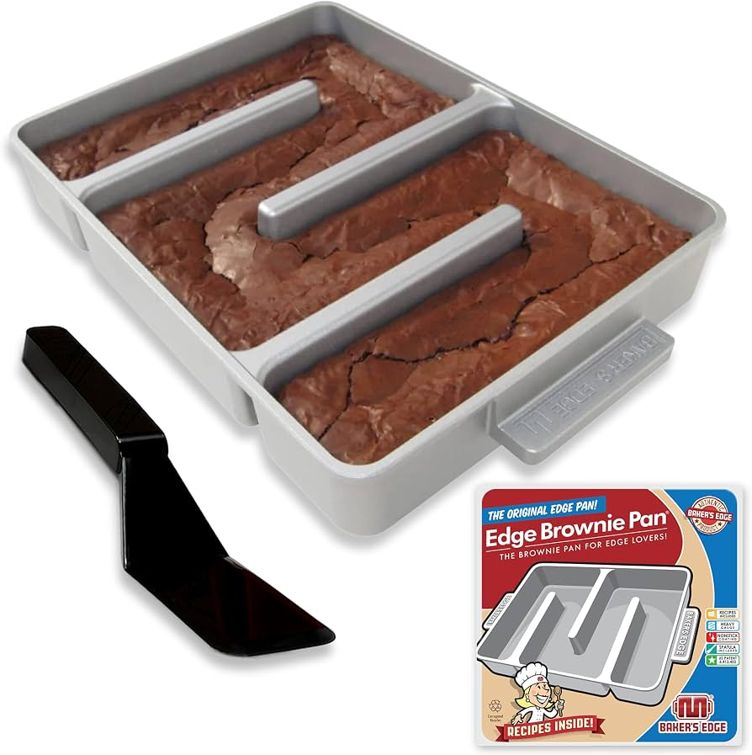
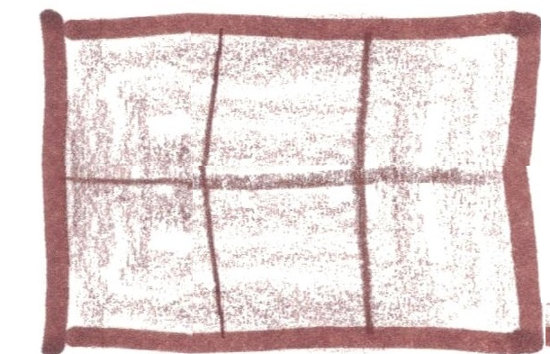
For more edges, go small…
…or skinny…
…or branchy.

Slide 22
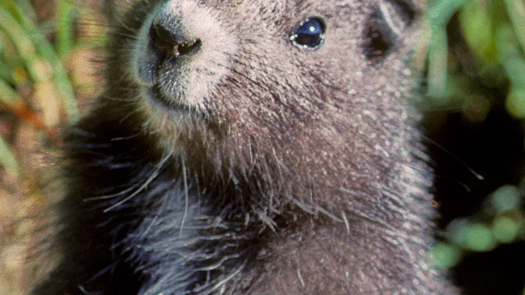
Life is governed by the balance between interior and exterior.

Slide 23
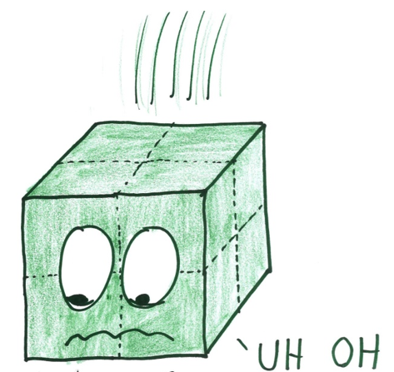
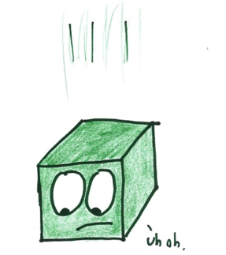


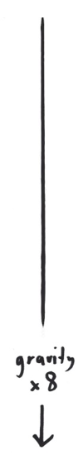
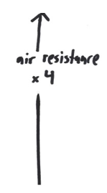
Example #1: Falling.
Gravity speeds a fall.
It depends on mass, i.e., middle brownies.
Air resistance slows a fall.
It depends on surface, i.e., edge brownies.

Slide 24
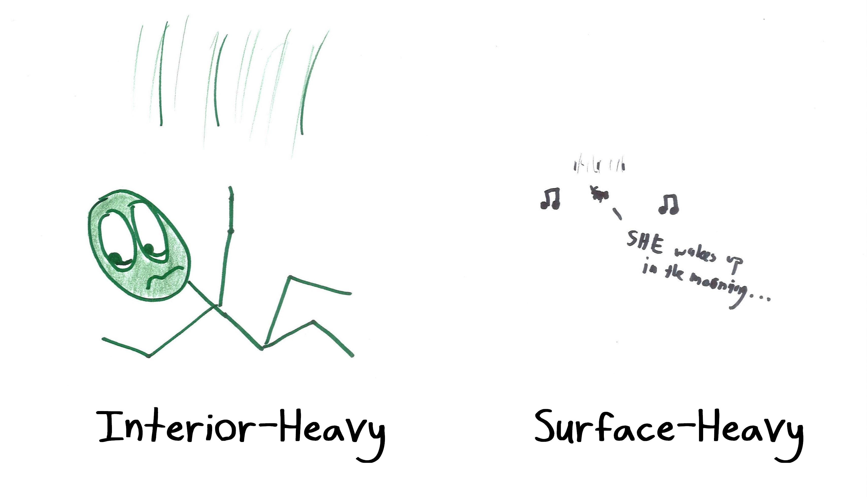

Slide 25
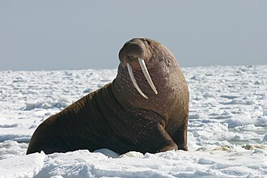
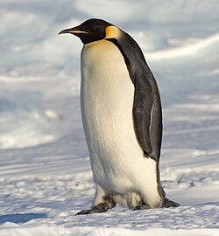
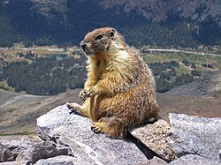
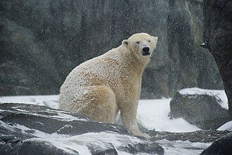
Example #2: Cold Climates
Metabolism keeps you warm.
It depends on mass, i.e., middle brownies.
In the cold, you want a big, round body.

Slide 26
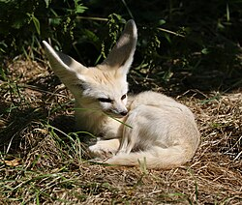
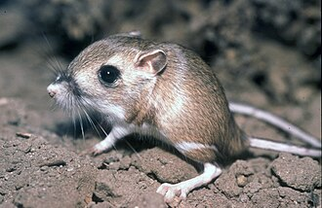
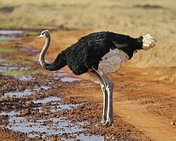
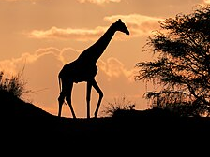
Example #3: Hot Climates
Heat loss cools you down.
It depends on surface, i.e., edge brownies.
In the heat, you want a skinny little branchy body.

Slide 27
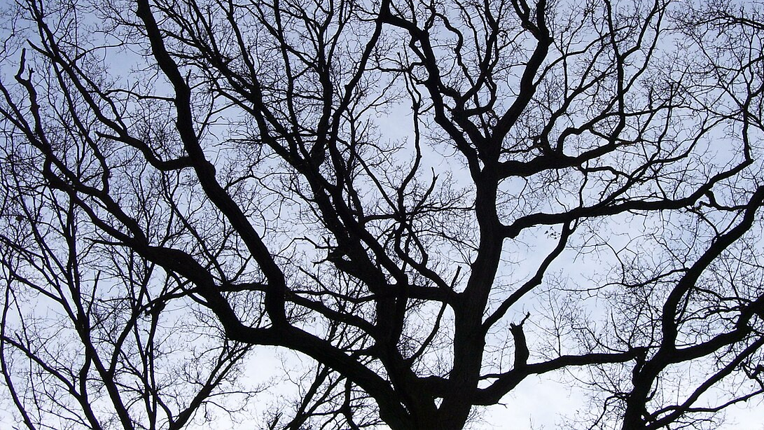
Example #4: Trees
You want lots of edge brownies (to capture energy).
You want fewer middle brownies (which need energy).
Hence: branching.

Slide 28
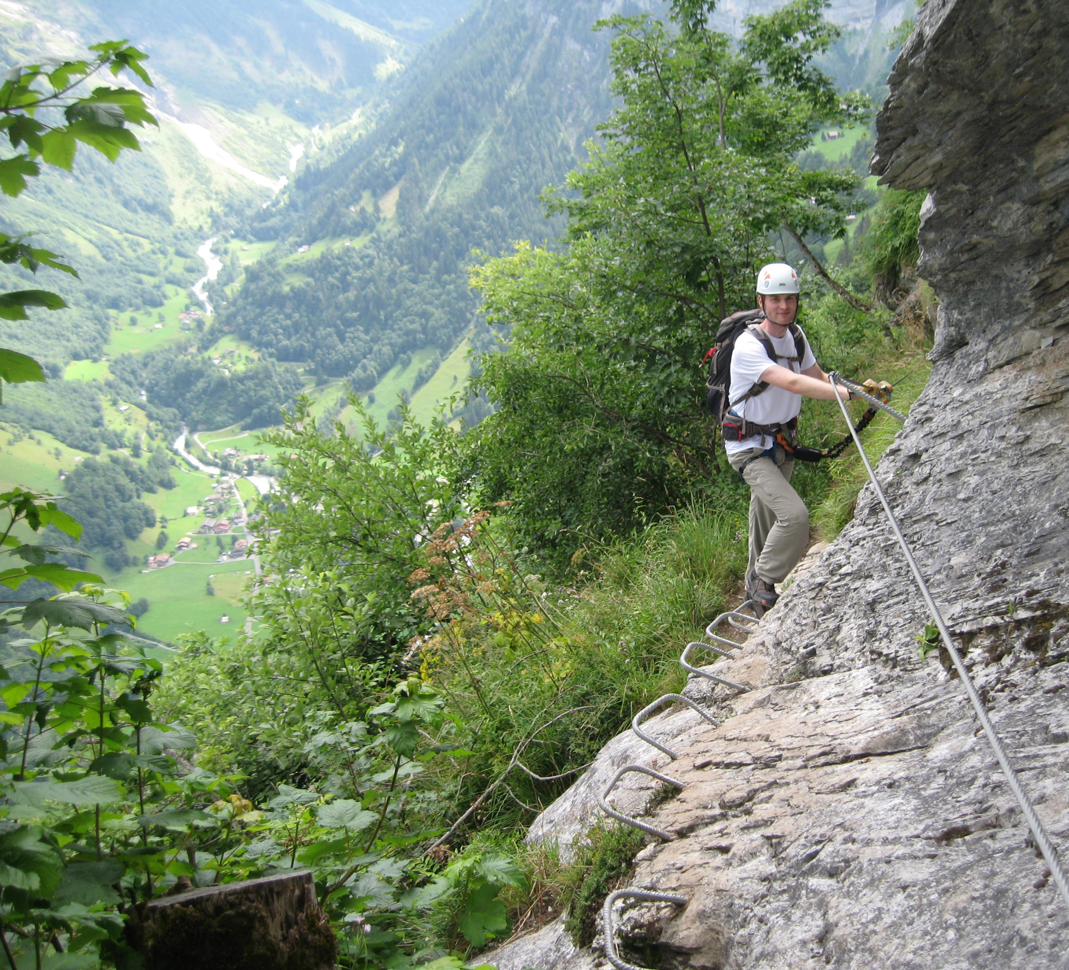
“Why is geometry often described as 'cold' and 'dry'? One reason lies in its inability to describe the shape of a cloud, a mountain, a coastline, or a tree. Clouds are not spheres, mountains are not cones, coastlines are not circles, and bark is not smooth….”
Benoit Mandelbrot, The Fractal Geometry of Nature

