Slide 1
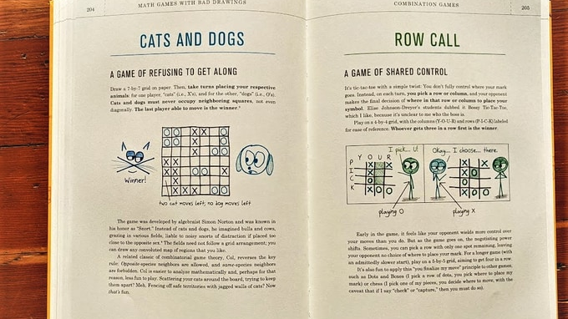
How to Curate Cool Math Stuff
Ben Orlin
MFPE 2026

Slide 2
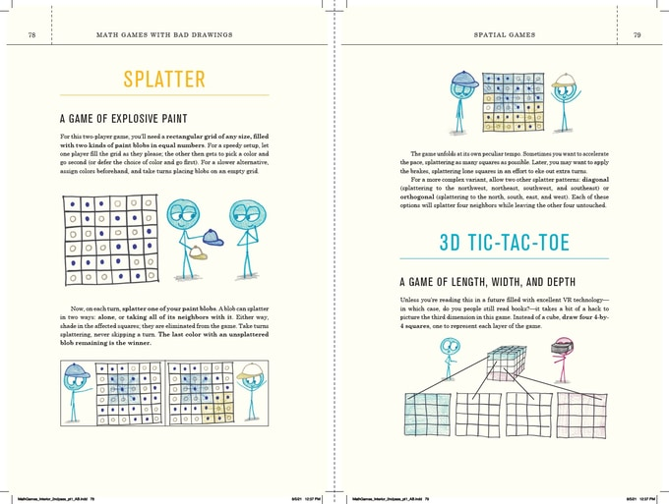
What We’ll Cover
What to curate
Why to curate
How to curate
Get curating!

Slide 3
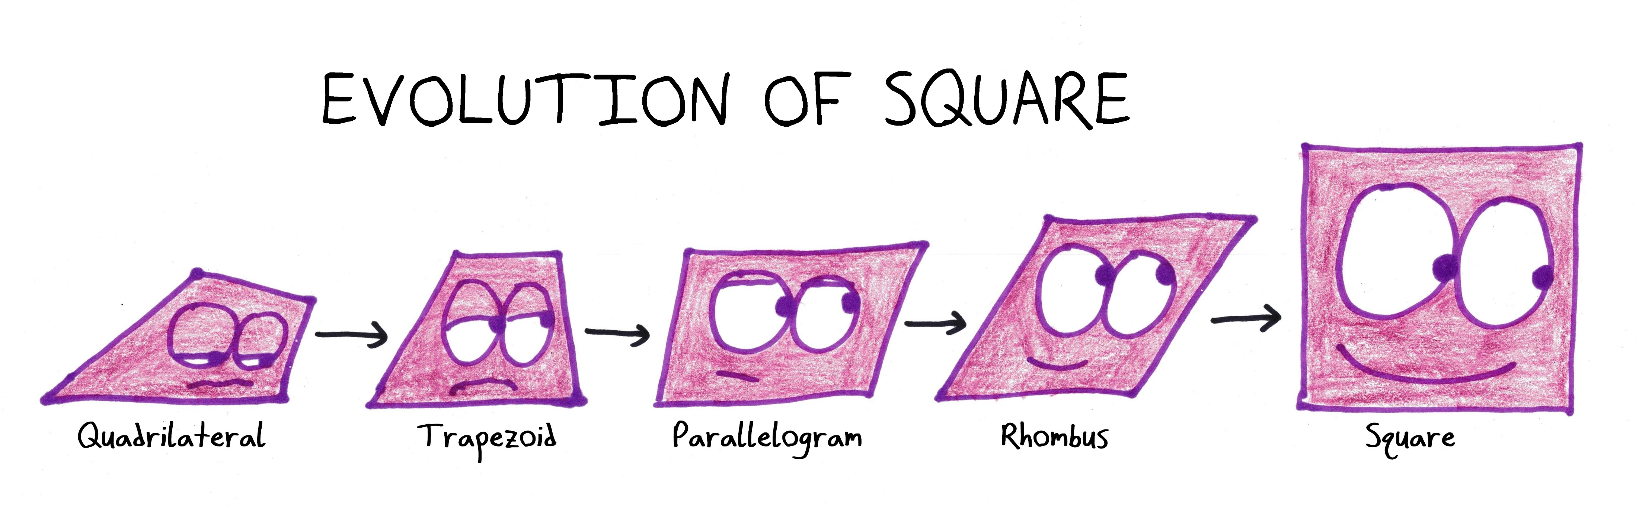
What to Curate?

Slide 4

Memes

Slide 5
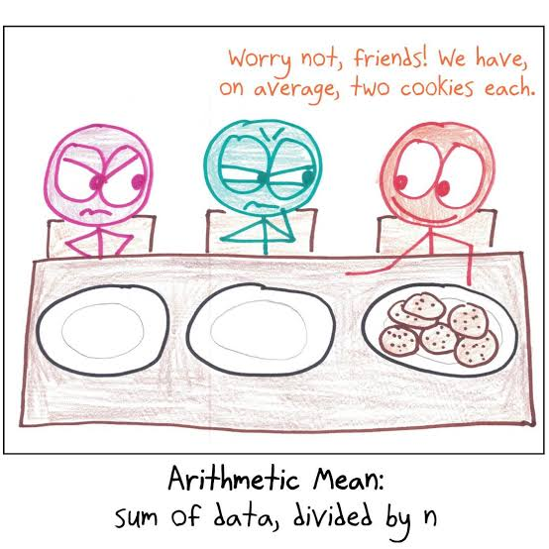
Cartoons

Slide 6
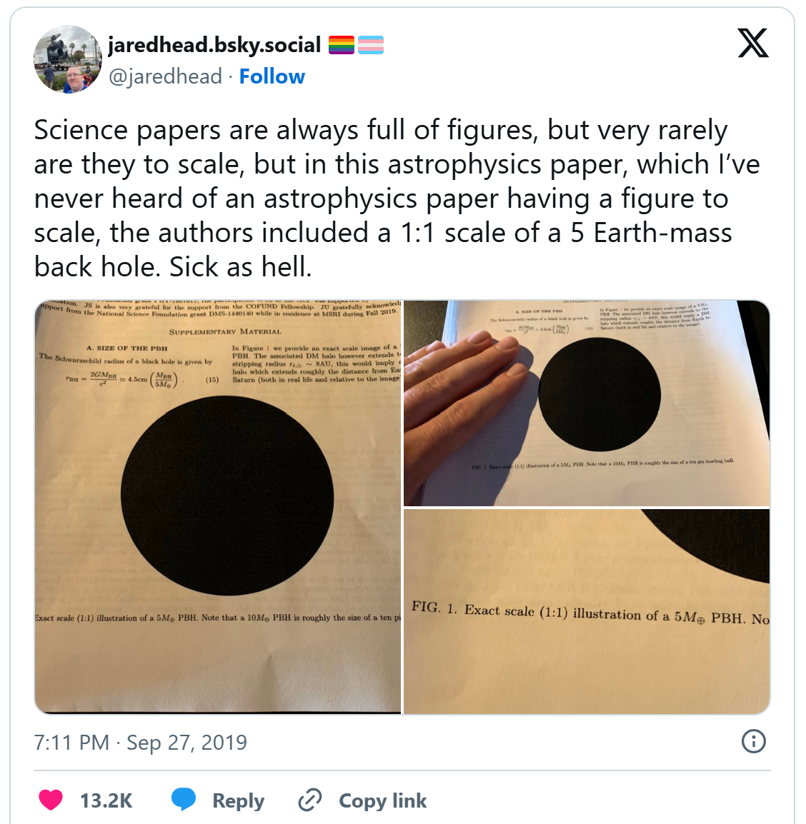
Facts

Slide 7
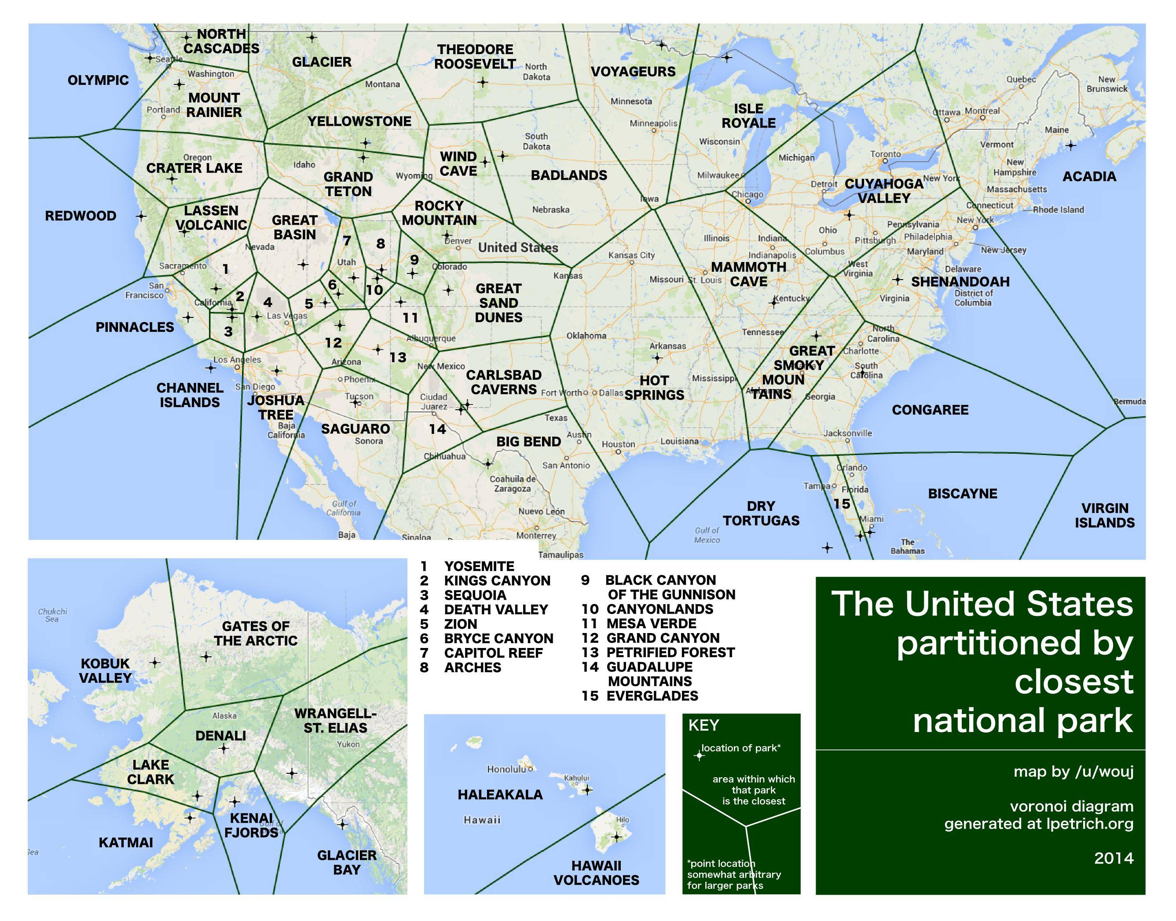
Maps

Slide 8
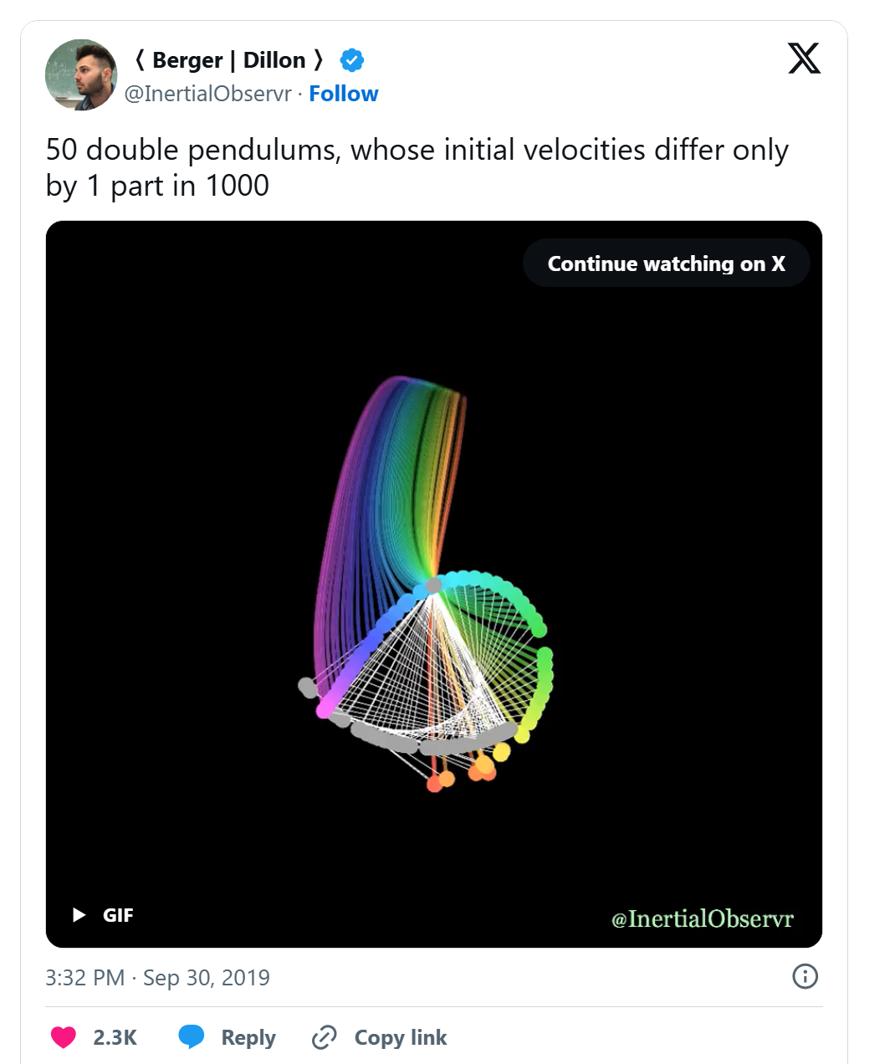
Animations

Slide 9
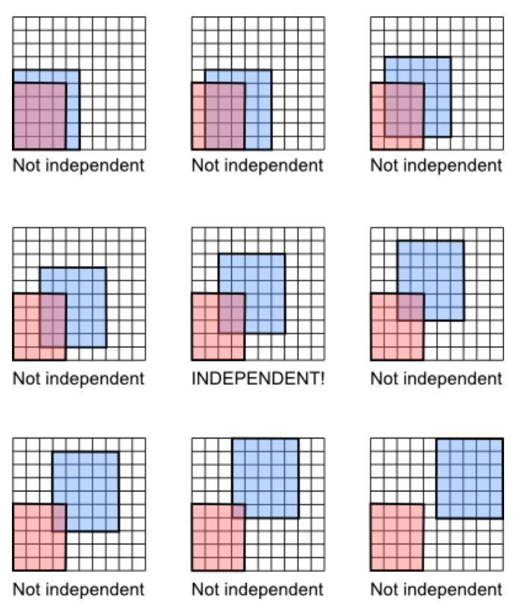
Illustrations

Slide 10
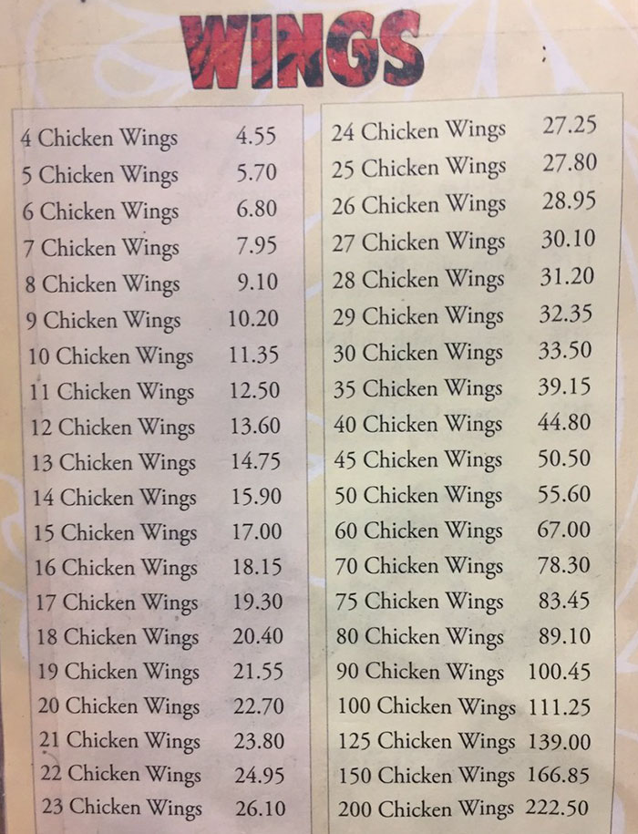
Photos

Slide 11
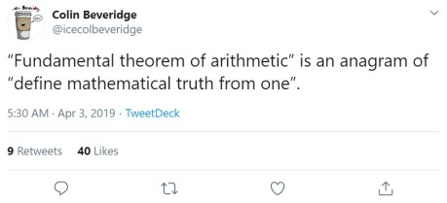
Language Tidbits

Slide 12
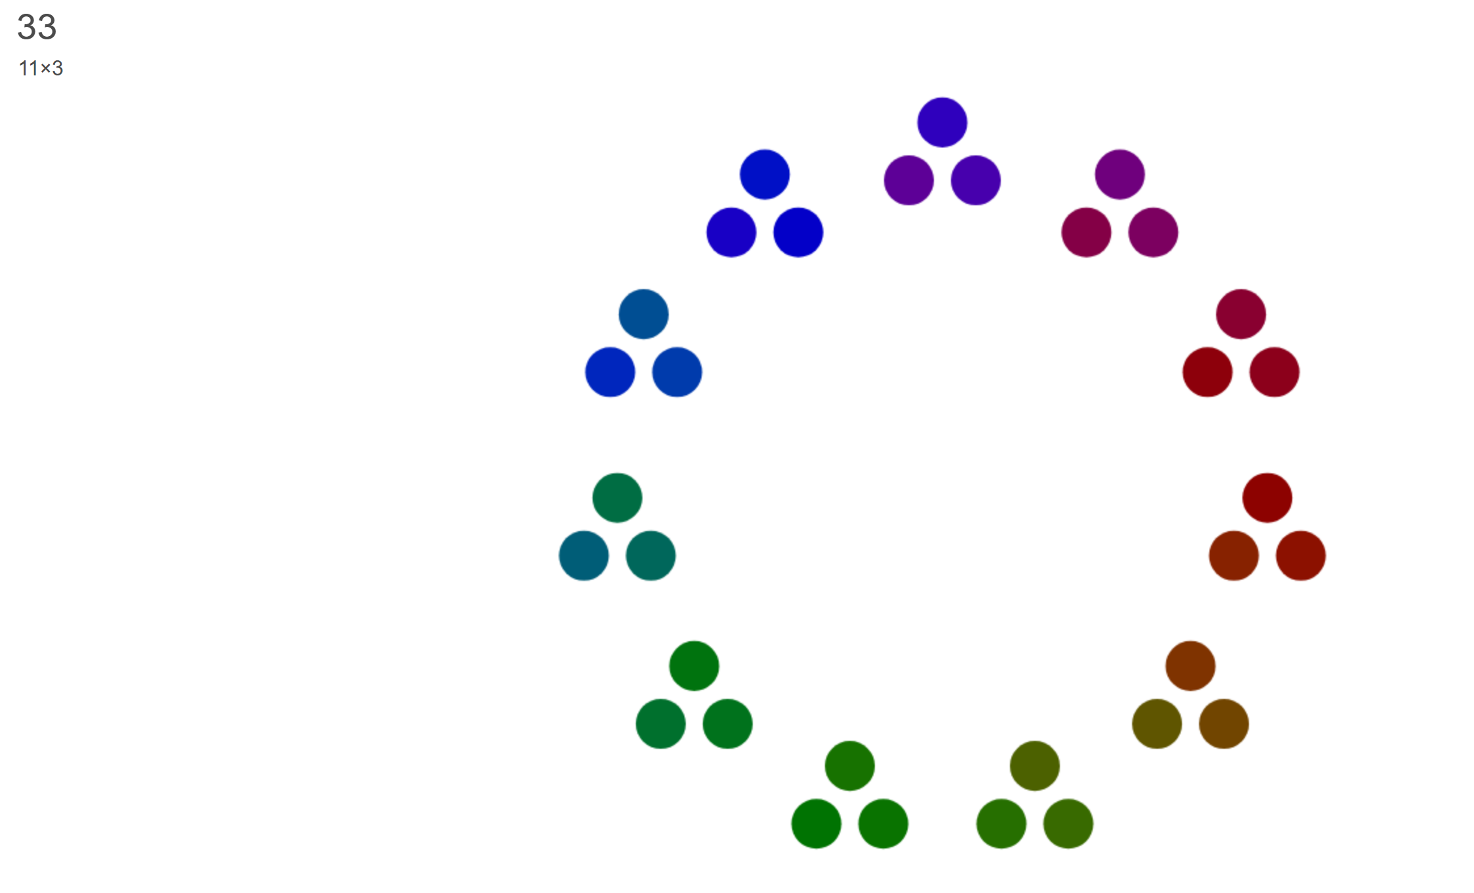
Interactives

Slide 13
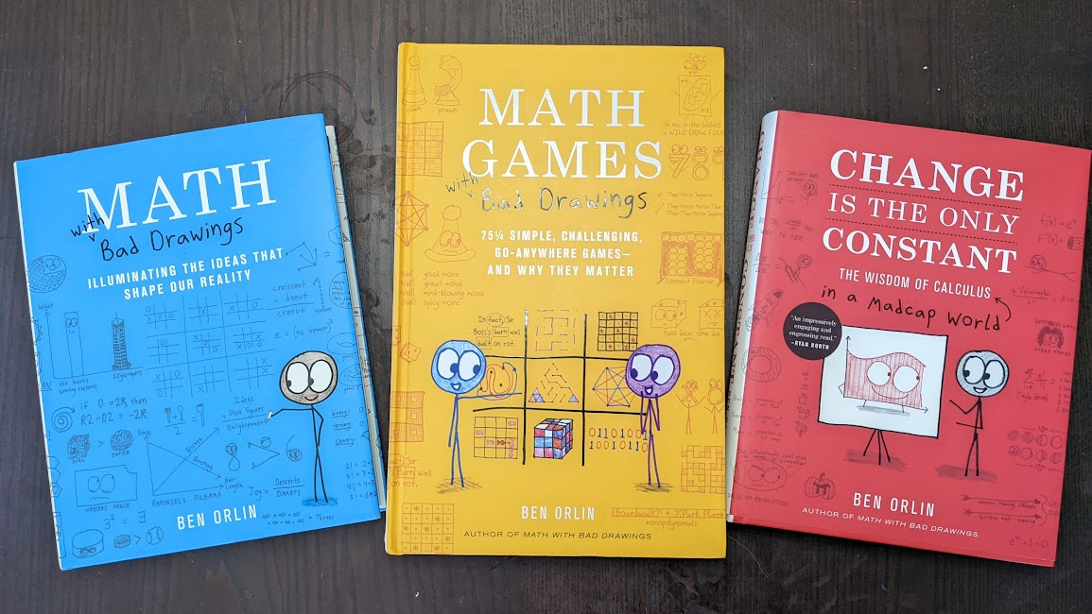
Books

Slide 14
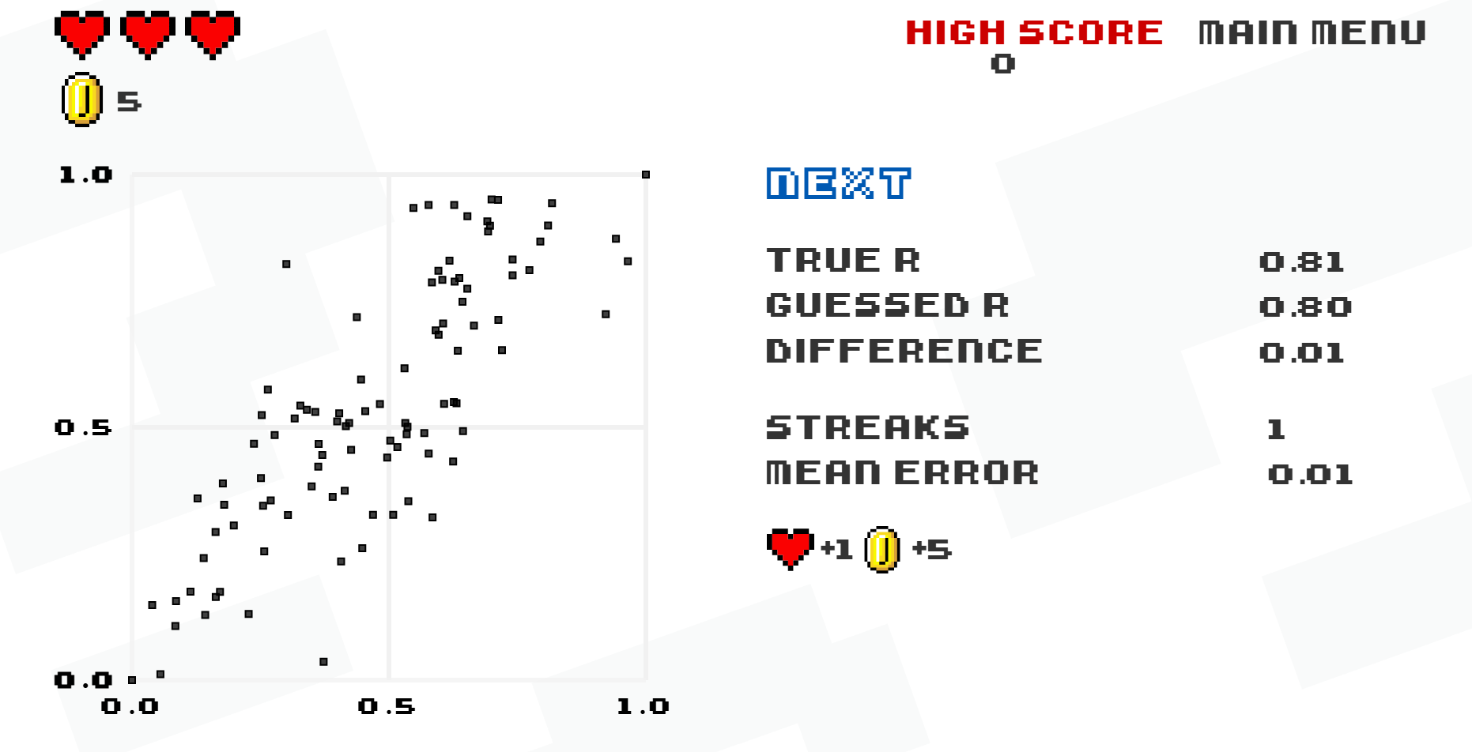
Games

Slide 15
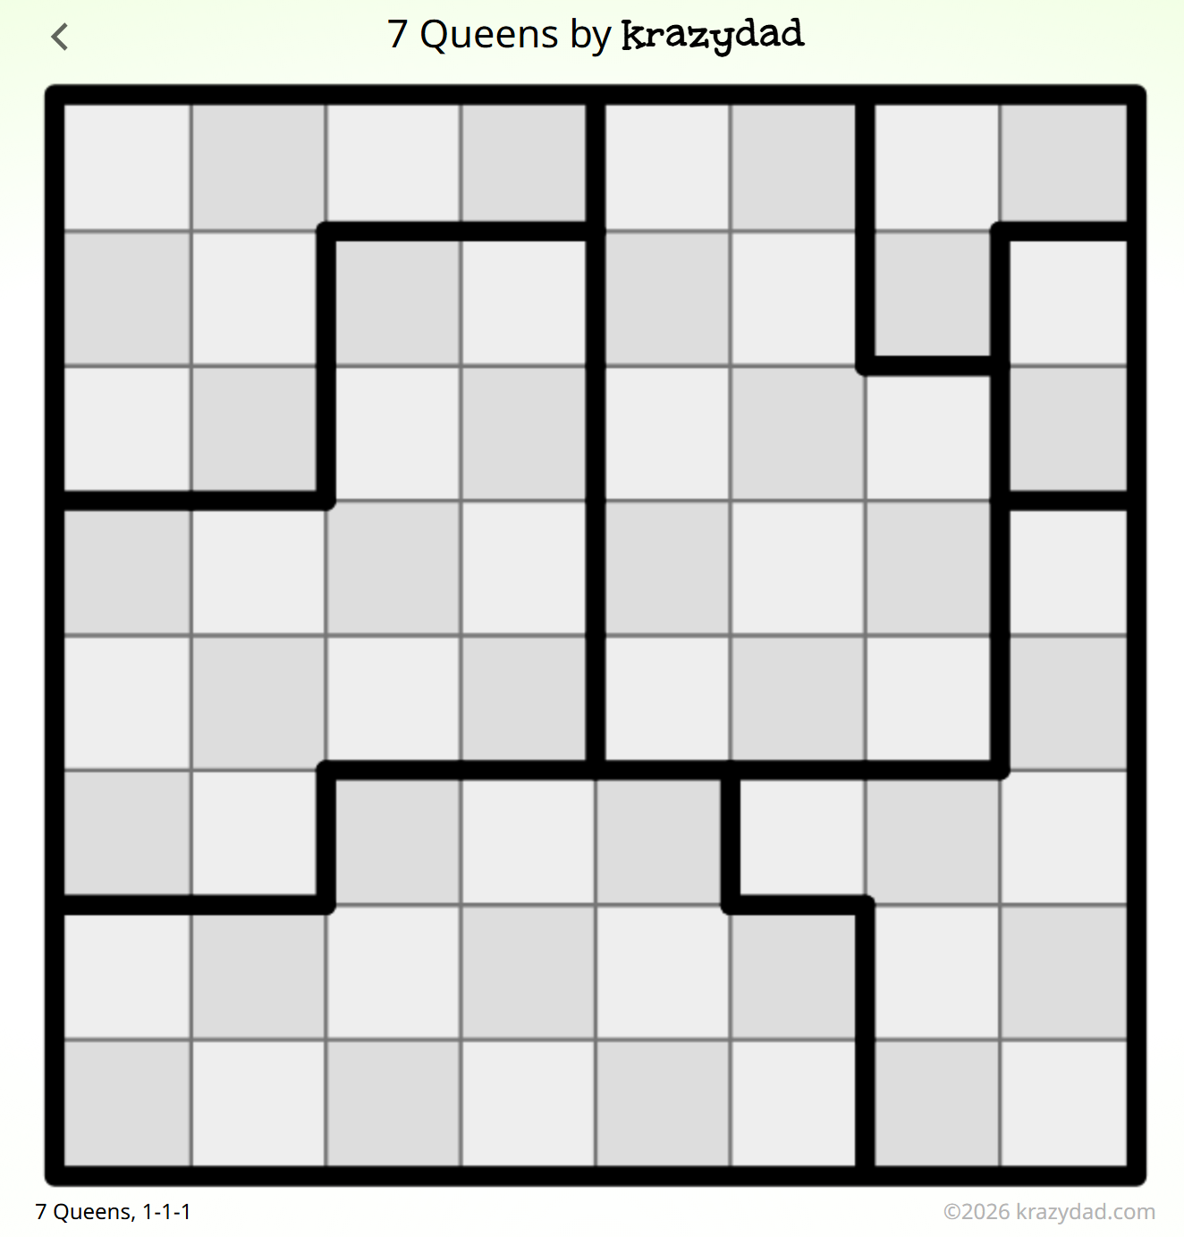
Puzzles
(Off-Topic)

Slide 16
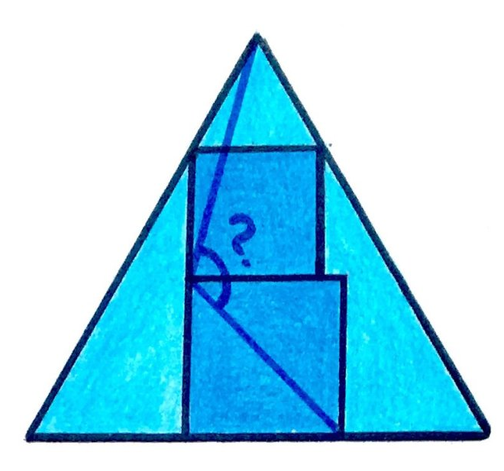
Puzzles
(On-Topic)

Slide 17
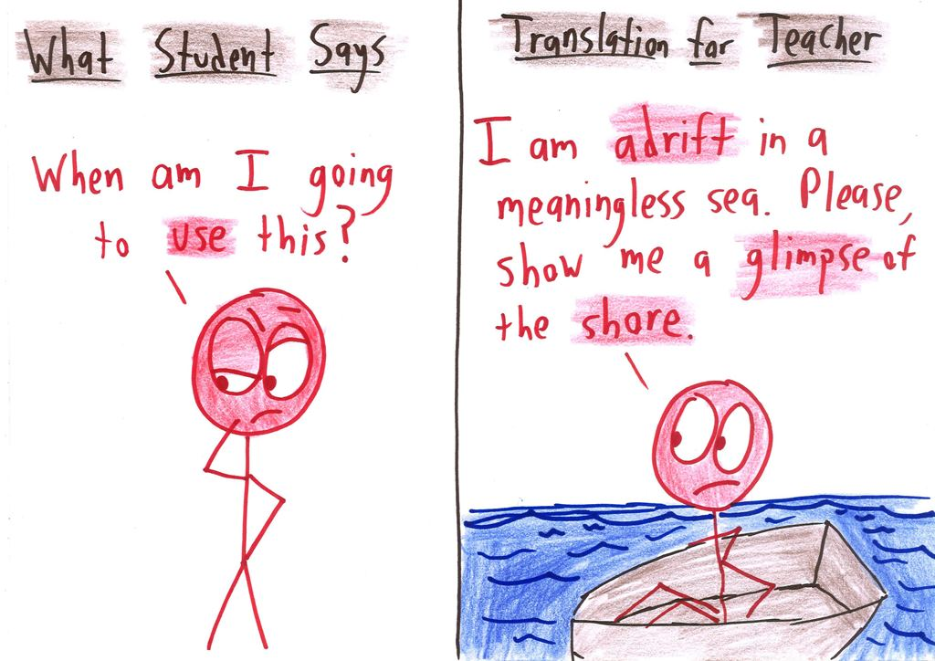
Why to Curate?

Slide 18
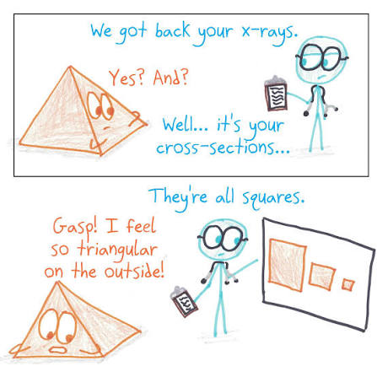
1. Hooks
On-topic
Visual
Clear
Quick
Content-rich

Slide 19
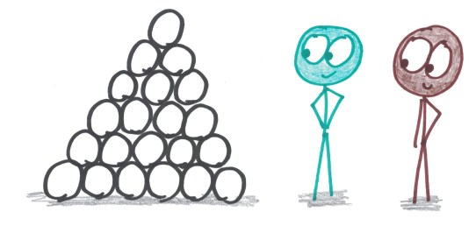
2. Flourishes
Pleasurable
Inspirational
Rejuvenating
Not too slow
Semi-relevant

Slide 20
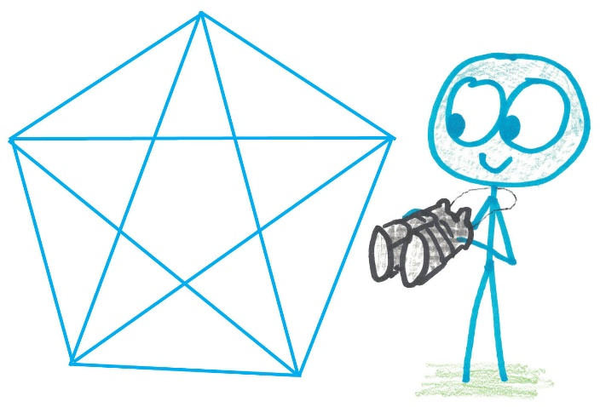
3. Extension
Deep
Playable
Explorable
Independent
Time-soaking

Slide 21
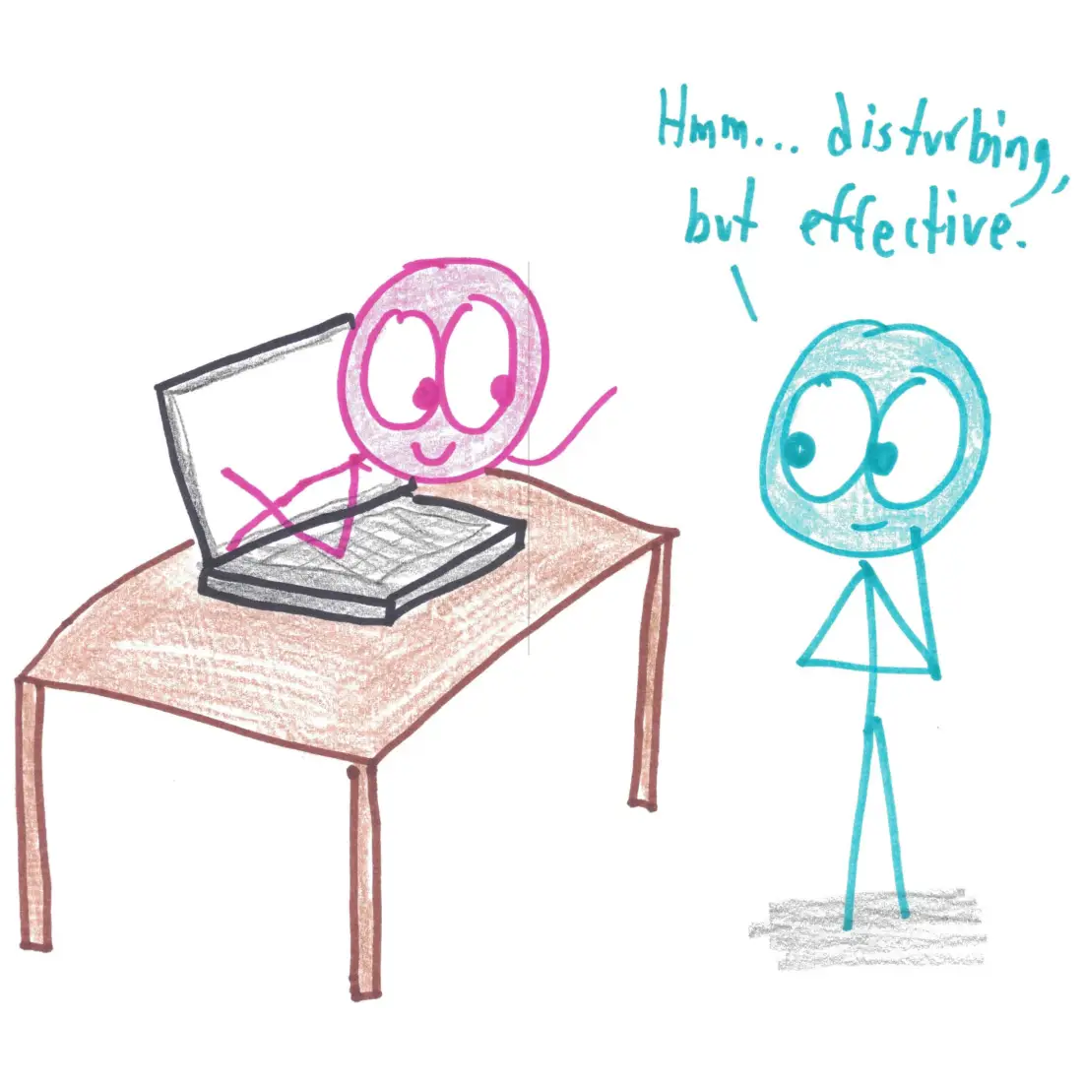
How to Curate?

Slide 22
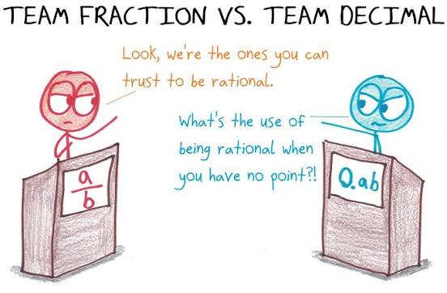
Places to Start
Videos: Numberphile, Standup Maths, Ted Ed, 3Blue1Brown…
Puzzles: Krazy Dad, Brilliant, Art of Problem Solving…
Games: Math for Love, Math Games with Bad Drawings…
Social Media: Good luck

Slide 23
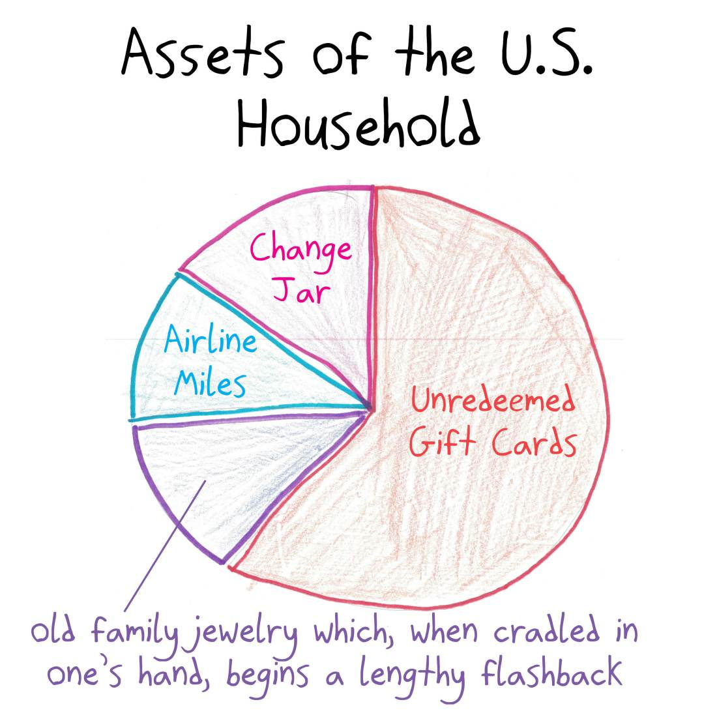
My Approach: the Bank of Flourishes
Comb through existing sources.
Collect only what is ready to use.
Build yourself a bank of flourishes.
Later, as you go, align them to lessons.
Hooks are just the best 3% of flourishes.

Slide 24
Let’s Begin!
Find a table of people teaching the same course or content.
Share what you’re looking for.
Share what you have.
Search together!

