Slide 1

How to Spreadsheet (and Why)
Ben Orlin
MFPE 2026

Slide 2
How would you describe your level of spreadsheet fluency?
“I don’t understand a word of it”
“I can understand others’ spreadsheets but can’t produce a spreadsheet myself”
“I’m conversational; I know a few formulas”
“I’m fluent or close to it; for example, I know the difference between A$2, $A2, and $A$2”

Slide 3
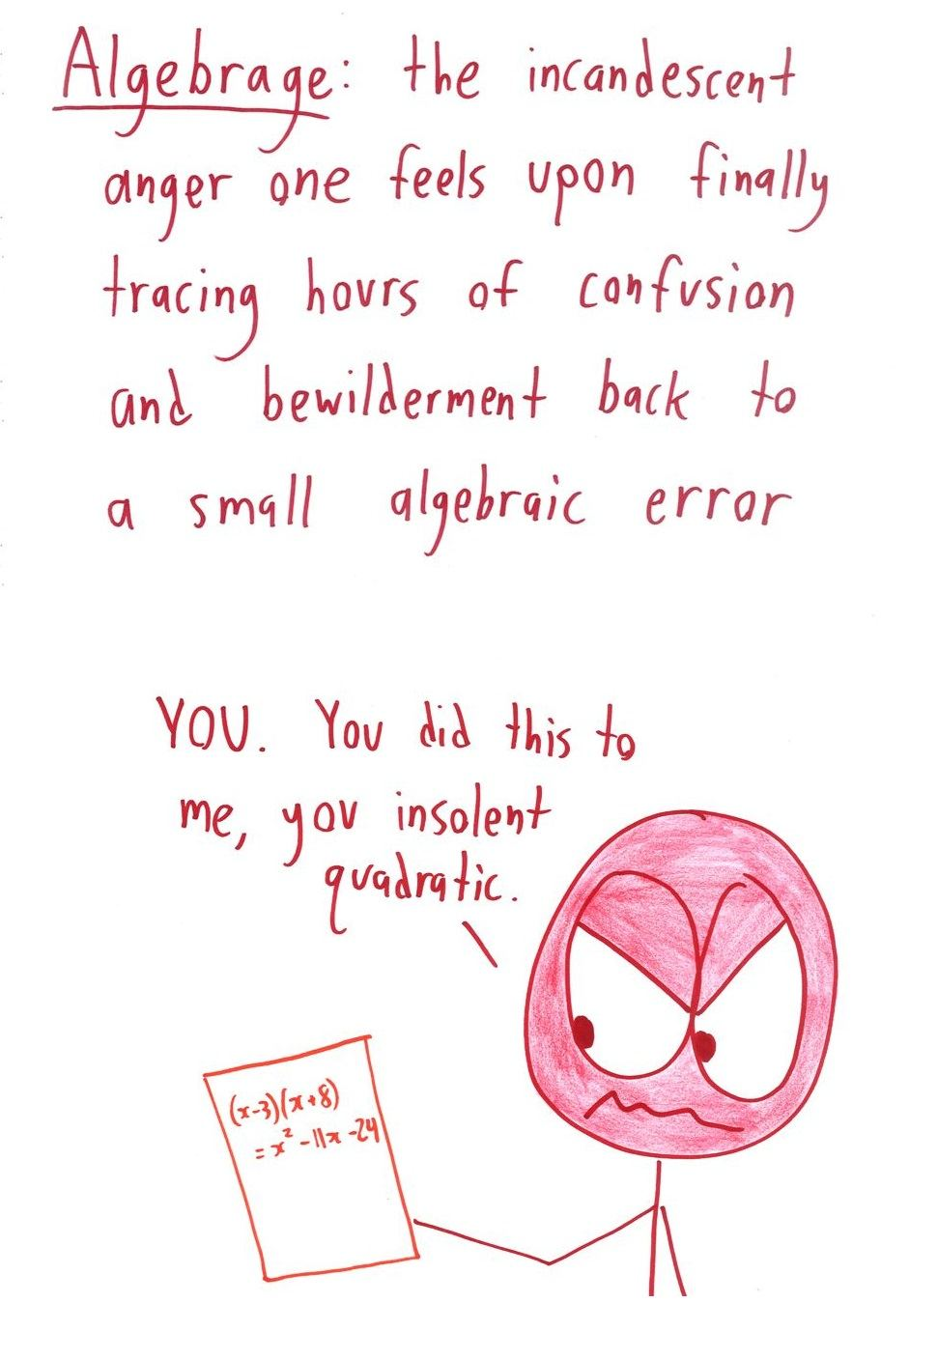
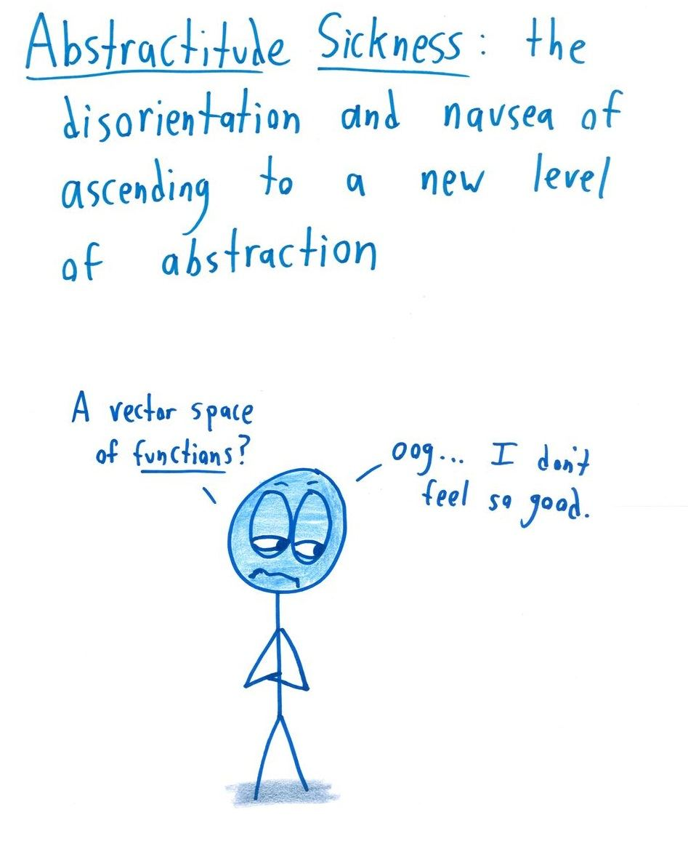
Do you or your loved ones struggle with these symptoms?

Slide 4
Cognitive symptoms:
Not accepting a variable as standing for a huge variety of numbers
Thinking recursively (7, 14, 21, 28… ah, it’s n + 7) when explicit thinking is required (7, 14, 21, 28… ah, it’s 7n)
Failing to connect different manifestations of linear growth

Slide 5
Emotional symptoms:
Deep suspicion of algebraic variables (and algebra in general)
Sense of distance and disempowerment
Burning desire to know “when” we are going to “use” “this”

Slide 6
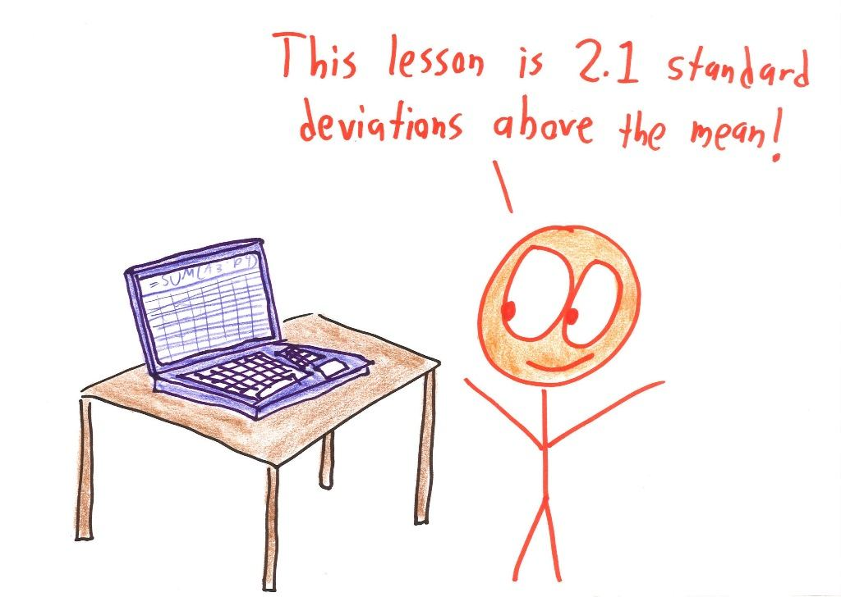
Not to worry. There is a treatment.

Slide 7
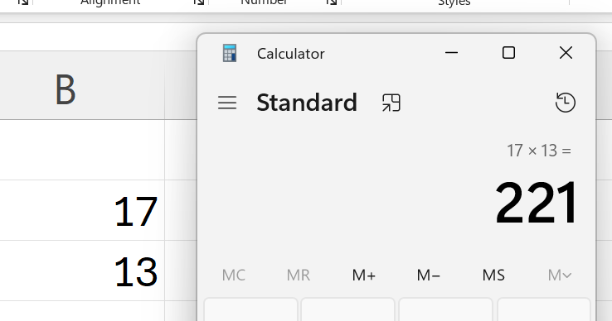

Phase 1: Excel as Piece of Paper
Students calculate in a separate app and type results into Excel.

Slide 8
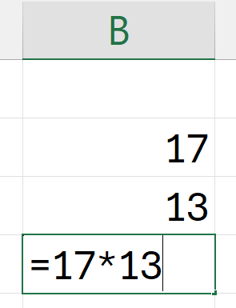

Phase 2: Excel as Calculator
Students calculate in Excel by retyping numbers.

Slide 9

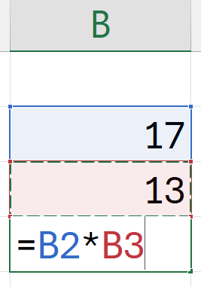
Phase 3: Excel in its Full Glory
Students embrace Excel as a visual interface for algebraic logic.

Slide 10
Today: a 2-hour version of a 13-week course
Newcomers: start at lesson 1
Novices: glance at 1, dive into 2
Conversational: glance at 1, 2, 3
Experts: glance them over; you may enjoy 7-10

Slide 12
A tale of two spreadsheets
The Data Report
The Algebraic Interface

Slide 13
A tale of two spreadsheets
Values: get the correct number
References: get the correct dependence between numbers

Slide 14

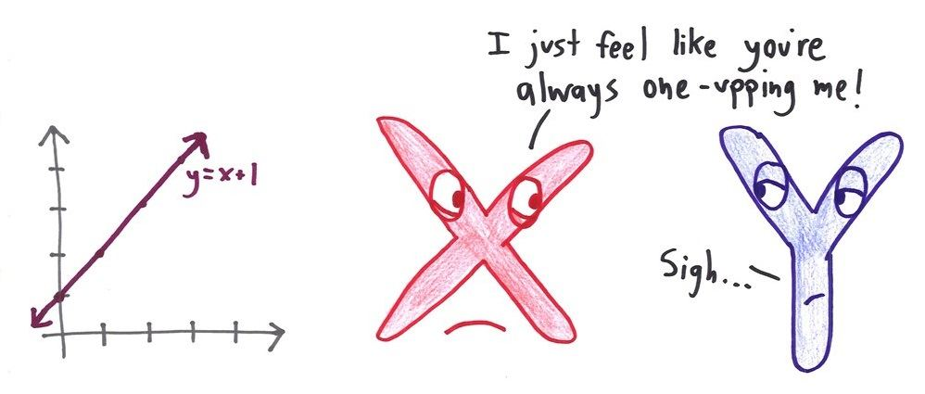
A tale of two spreadsheets
Functions: let’s apply the appropriate built-in tool
Formulas: let’s express the key calculations in abstract terms

Slide 15
A tale of two spreadsheets
Formatting: use color and style to make it look professional
Formatting: separate the formatting (decimal places, dollar signs) from the content

Slide 16
A tale of two spreadsheets
Charts and Pivot Tables: let’s summarize the data
COUNTIFS, SUMIFS, etc.: let’s ask questions of the data

