Slide 1
Distributive Genies
15th June, 2017
Ben Orlin
Math with Bad Drawings

Slide 2
What is $17×6$?

Slide 3
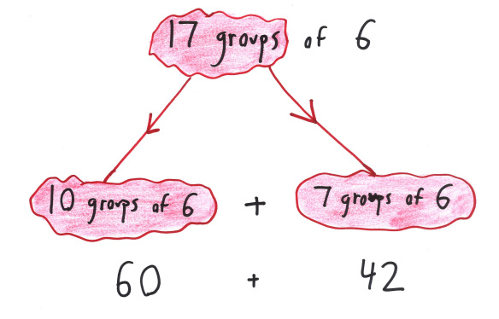
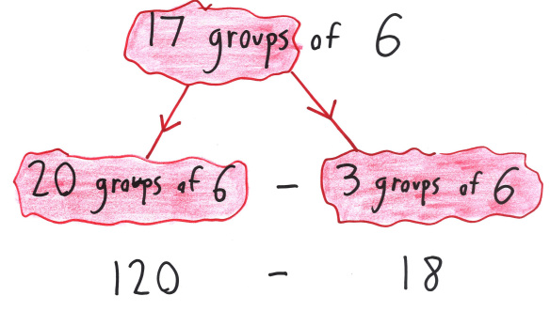

Slide 4
The Distributive Property

Slide 5
Algebraic Uses
Where Distribution Leads

Slide 6
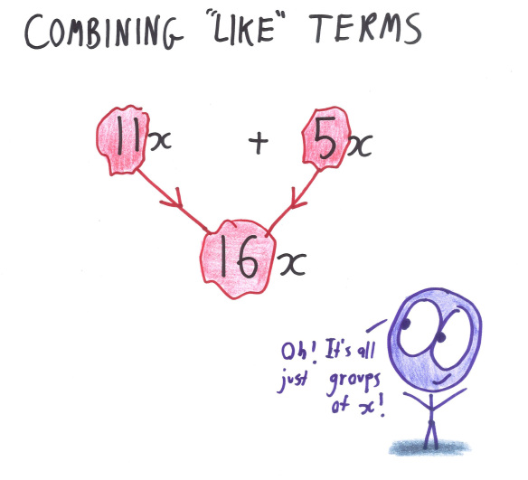
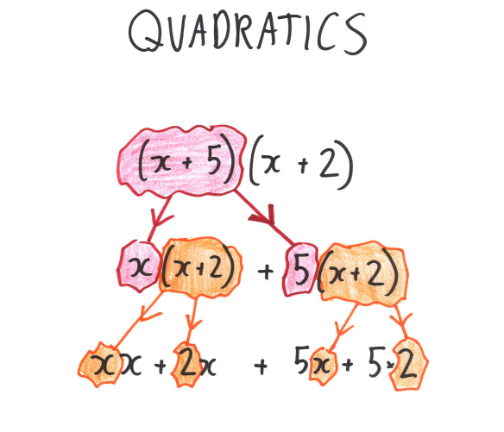
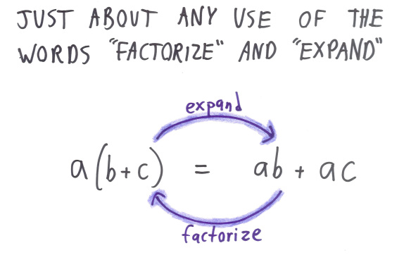

Slide 8
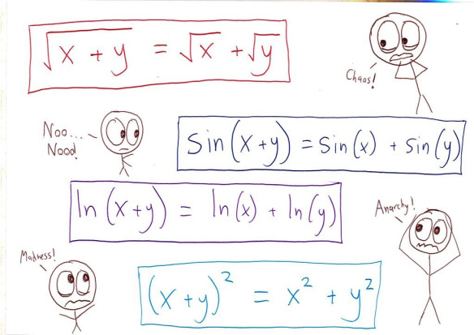
The “Everything is Linear” Error

Slide 9
Models for Thinking
How do we picture distribution?

Slide 10
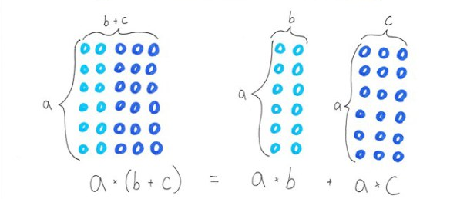
Area Models

Slide 11

Money Models
$3(x+2)$ = $3$ bags, each with $x+2$ pounds
$3x+2$ = 3 bags of $x$ pounds each, $+ 2$ pounds

Slide 12
Money Models
Gives you $4 THEN Doubles your money
Doubles your money THEN Gives you $4

Slide 13
Play around!

Slide 14
How do we respond?
1. “Which genie? They’re both the same, so it doesn’t matter.”
2. “Which genie? Well, it depends how much money you have.”
3. “OK, I’m done! I just plugged in 10 for each.”
4. “OK, I’m done! I just expanded the brackets.”
5. “Why do I have to use ‘x’? It’s easier with numbers.”

Slide 15
Extension
Triple genies (and you pick the order)
Nonlinear genies (composition of functions)
Design-your-own genies (to fit certain criteria)
All materials available at http://mathwithbaddrawings.com/genies

